Slide 1

Data to Insights to Action a data analytics journey
Tracey Carmichael
Director, Research & Data Analytics
University of British Columbia
October 12, 2016
10:45 - 12:00

Slide 2
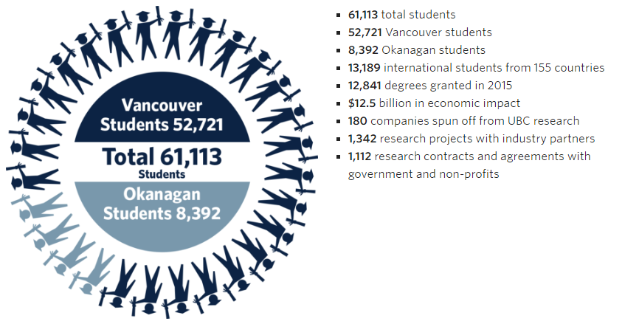
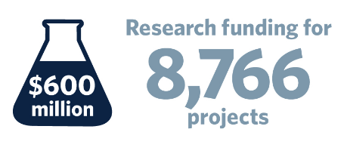
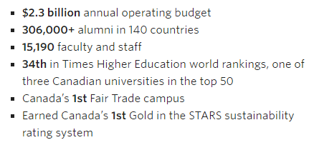
UBC at a glance

Slide 3

Our Mission: to sustain UBC’s margin of excellence through philanthropy and engagement
Raise $ 200 million + each year
Engage 55,000 + alumni annually

Slide 4
Data analytics journey: early days
US wealth screening
2002
Census wealth data linked to addresses
2010
Target Analytics: annual gift range & likelihood to give
2010
Predictive model for planned giving
2011

Slide 5

Early Challenges
invisible
Effort was
Adoption was staff dependant
Application was limited
Data quality was poor
Time to deliver was long

Slide 6
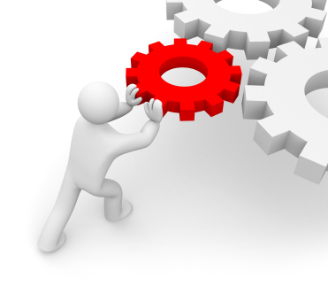
Lessons Learned
Find keen partners for data analytics initiatives but make sure you operationalize (and publicize) the results to benefit everyone
Weave deliverables – scores, dashboards, metrics, segments – into everyday processes
Every project builds the program

Slide 7
Getting Started
Leadership buy-in
Resource Planning
Selecting Projects
Managing Projects

Slide 8
Leadership Buy-in
Is fundraising driven by intuition or data? Art or science?
Acknowledge that data analysis is only ½ the solution
Do you achieve more with top-down direction or by working at the grassroots?
Know who your champions are and find kindred spirits
Show what you know
Pilots, prototypes, and visualizations tell data stories and build support

Slide 9
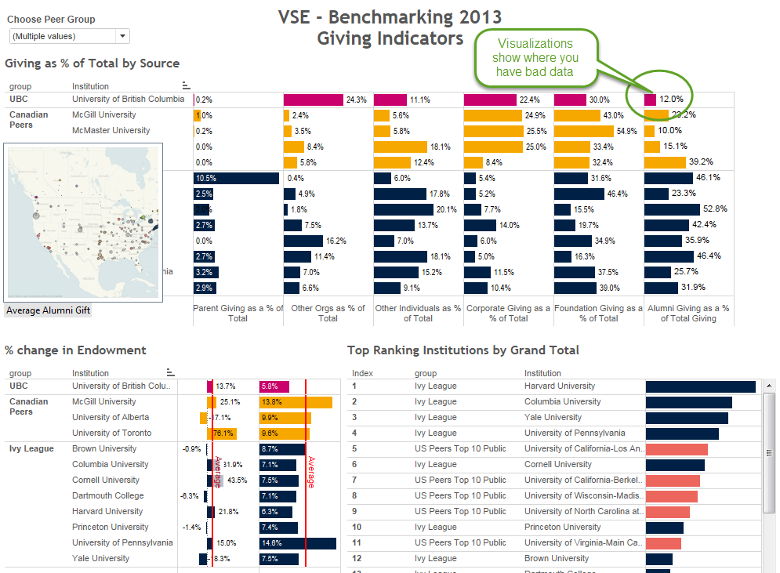
Benchmarking is a great proof-of-concept project to help communicate what you can do

Slide 10
Resource Planning
People
What talent do you have?
What talent do you need?
Data
Where can you get the data you need?
Can you fix your data problems?
Tools
How much faster with the right tools?
How can you share insights better?

Slide 11
Selecting Projects: Where to Start?
Show people your work to generate new ideas and pitch projects
Work with the hungry and the desperate
Focus on whatever is most important to your organization
Pitch ways you can save money (e.g.. In-house surveys)
Seek out those willing to innovate

Slide 12

Crappy data problems
(I know you have them too!)
Data is often ‘good enough’ for analysis
Cleansed data can be re-uploaded to the CRM
Visualizing crappy data can get people engaged in fixing it

Slide 13
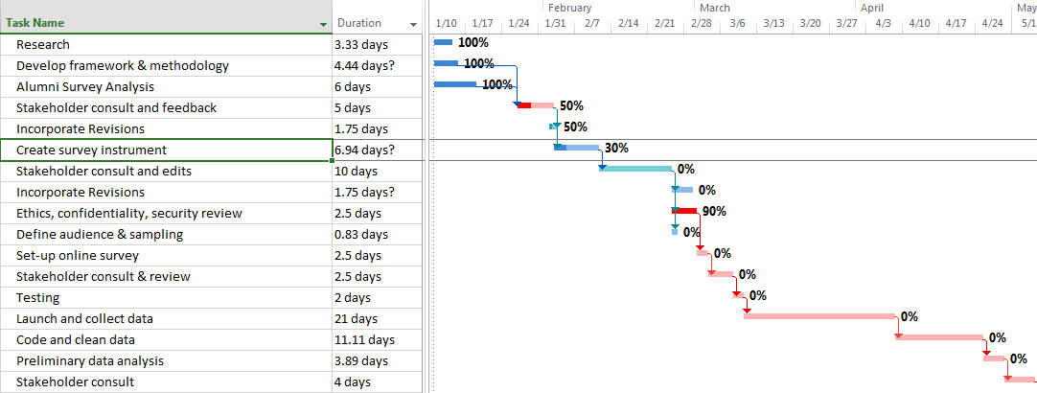
Managing projects
Expectations (should) go both ways
  Need commitment regarding success measures
  Expectations can be different than prospect research
Scope creep
  Wouldn’t it be nice to know ….
Project essentials
  Project scope document
  Plan
  Regular status meetings
  Prioritization process

Slide 14
Lessons Learned
Don’t over-sell the importance of data-driven decision-making to development leaders who rely on know-how and intuition – both are important!
Begin with what you have (talent / technology / data) and be prepared to buy what you need to deliver your projects
Your data is good enough – probably – and your program will make it better
Brainstorm ideas for using the analysis with client before you do anything and push for their commitment to measurable outcomes
Show and tell – again and again and again
Every project builds the program

Slide 15
Implementation & Change Management
Readiness & Trust
Deliverables
Self-service
Training & Support

Slide 16
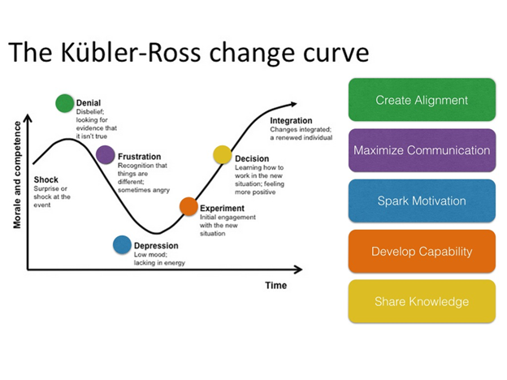

Slide 17
Are your fundraisers ready?
30%
Fundraisers who, armed only with analytic scores, would not contact a potential prospect that was qualified to give a major gift

Slide 18
Prove it! Building Trust
9 out of 10 UBC donors with high lifetime giving
live in neighbourhoods with major giving capacity

Slide 19
Deliverables
After working with consultants, you staff will have very high expectations!
Look at the deliverables from consulting projects and emulate
What people say they want is not always what they need
Graphs that will be included in board presentations and other high-level meetings need to follow branding standards
Create design standards for your analytics and consider infographics

Slide 20
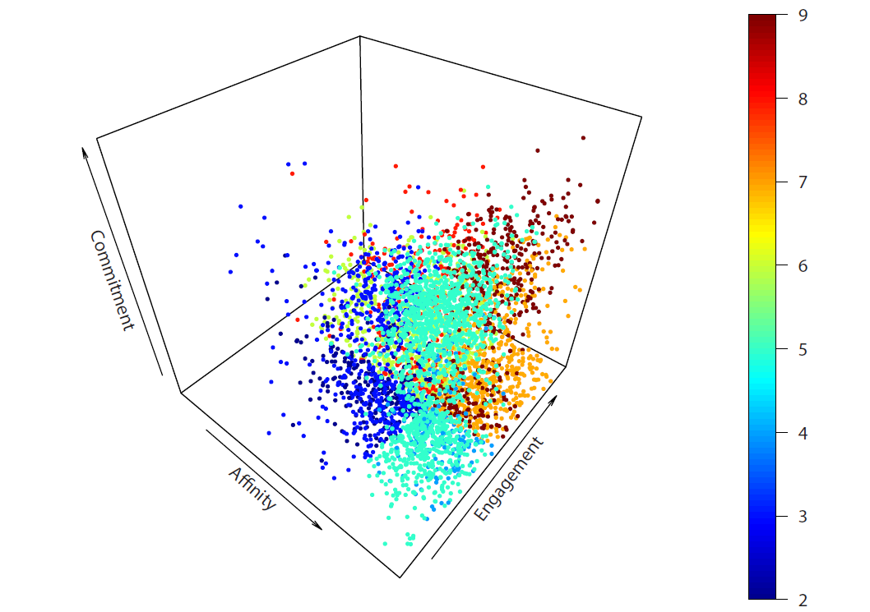
What they said they wanted….

Slide 21
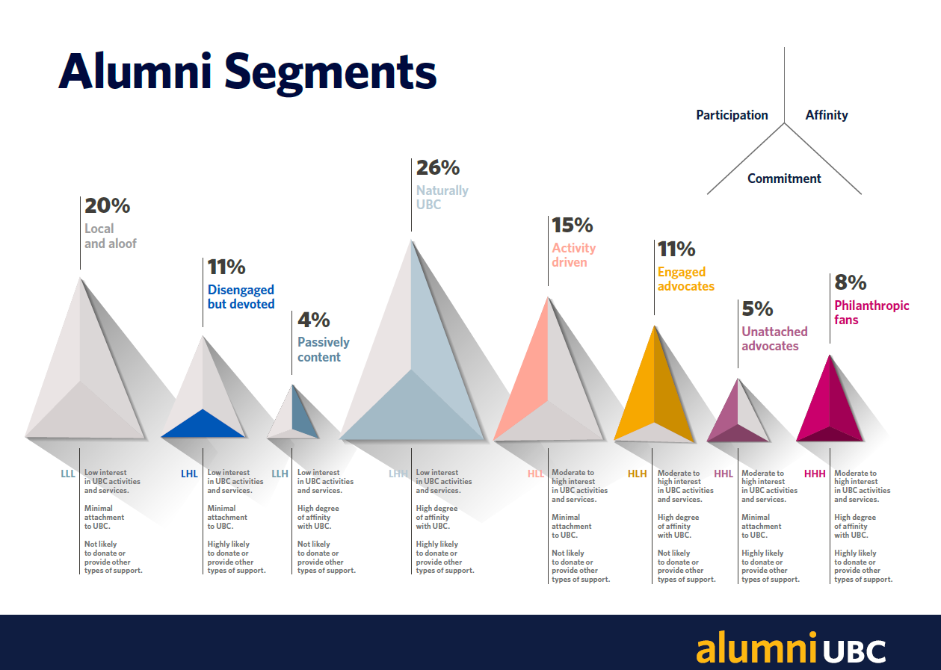
What they really wanted …

Slide 22
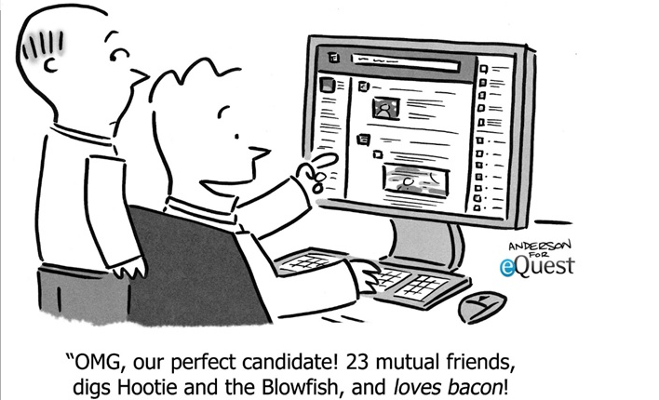
Expanding Fundraiser Filters

Slide 23
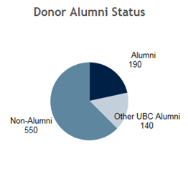
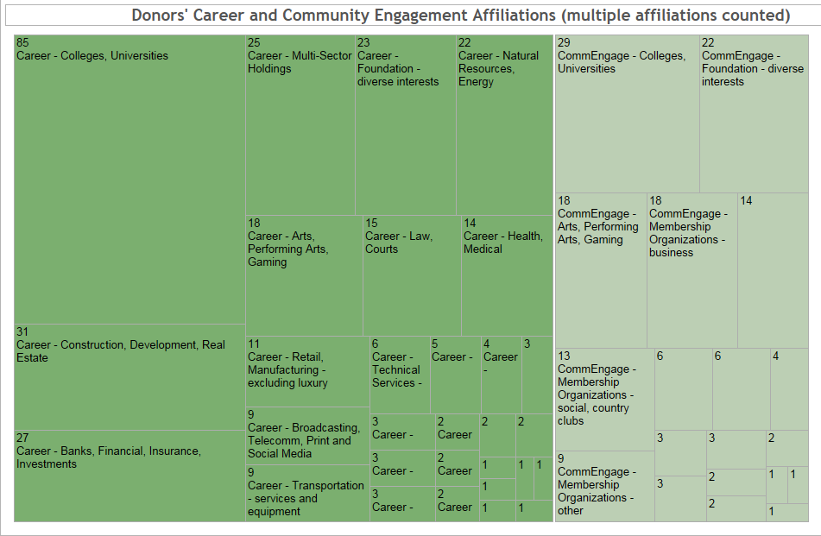
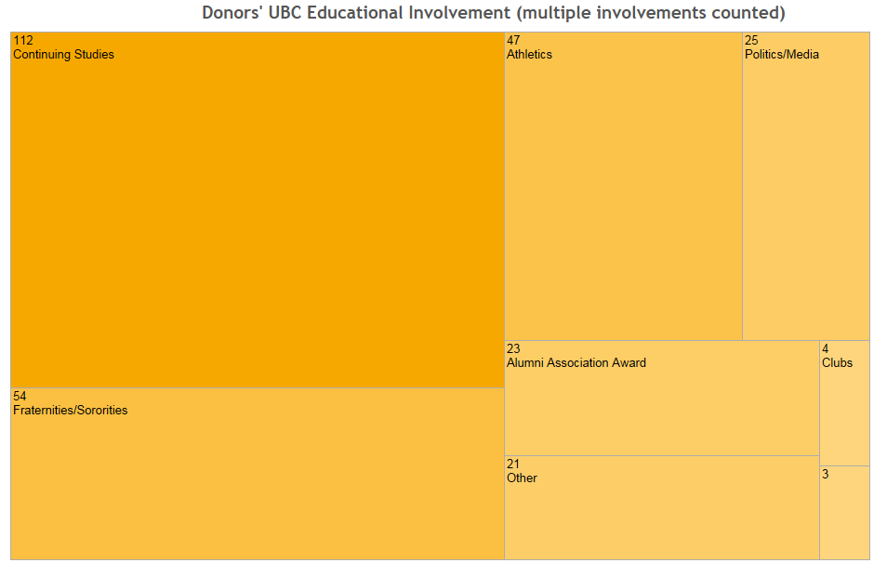
Donor Analysis: donations > $10,000

Slide 24

Neighbourhood-based Capacity Model
Wealth formula
Income
Liquid Assets
Average debt
Average real estate weighted by property threshold
Real Estate
Average income for age group weighted by income threshold
Average Liquid assets for age group weighted by asset threshold

Slide 25

Inclination to UBC Model
ENGAGEMENT
Participation in activities that are sponsored by or on behalf of UBC
AFFINITY
Feeling of emotional or intellectual closeness to UBC brand and community
COMMITMENT
Giving back to UBC
INCLINATION UBC
ENGAGEMENT
AFFINITY
COMMITMENT

Slide 26
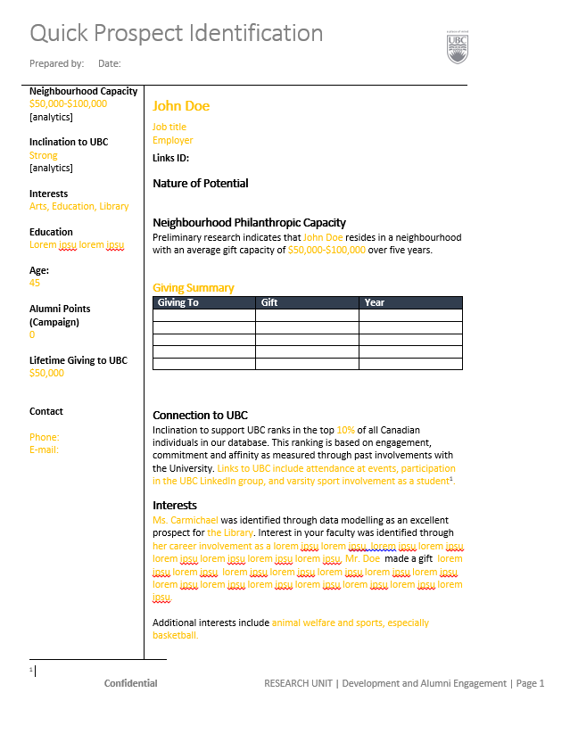
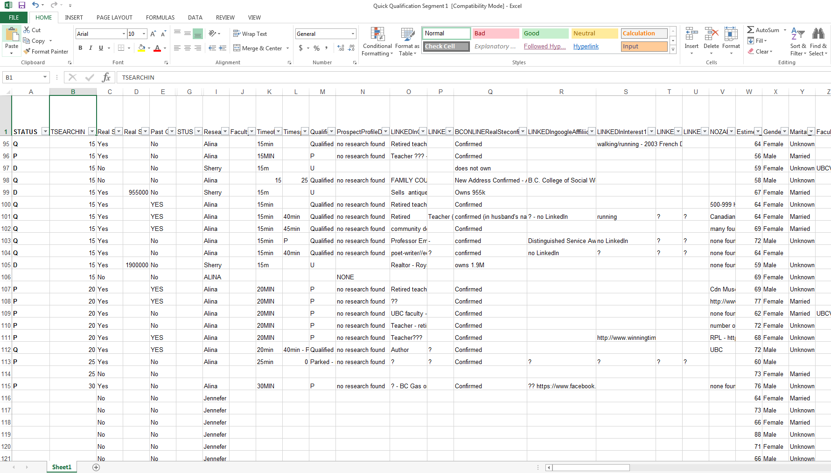
Research QPID Process

Slide 27
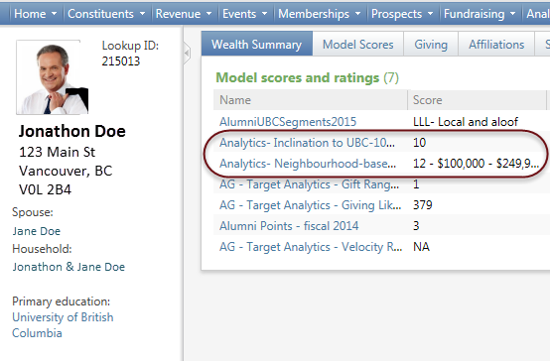
Self-Service & Training
Empowering people to uncover insights relevant to their work is the end goal
Spreading the work through prospect research is key to getting there
Self-serve tools liberate the data from your CRM and put it directly in the hands of people who need it everyday

Slide 28
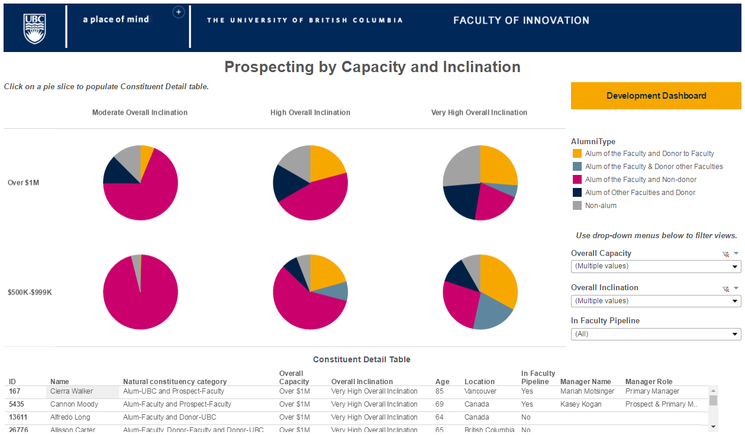

Slide 29
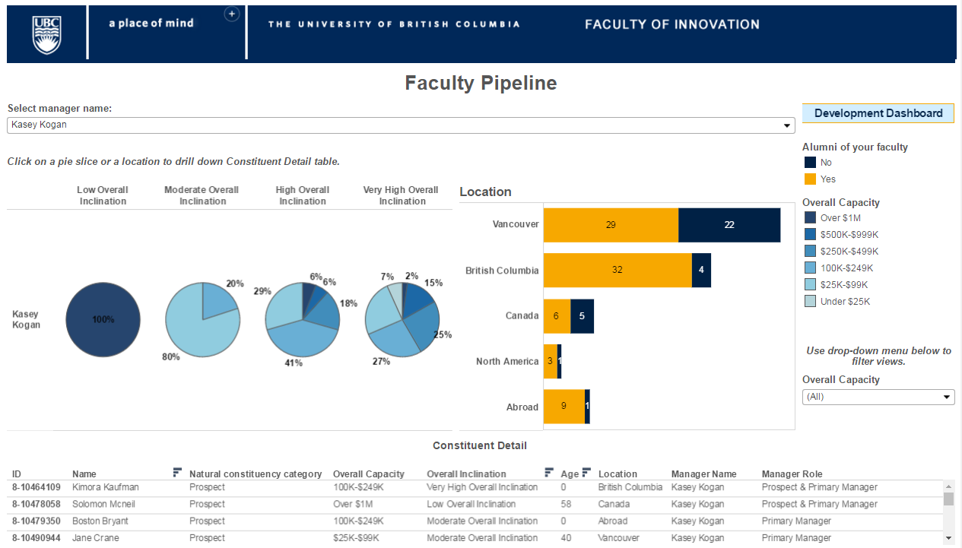

Slide 30
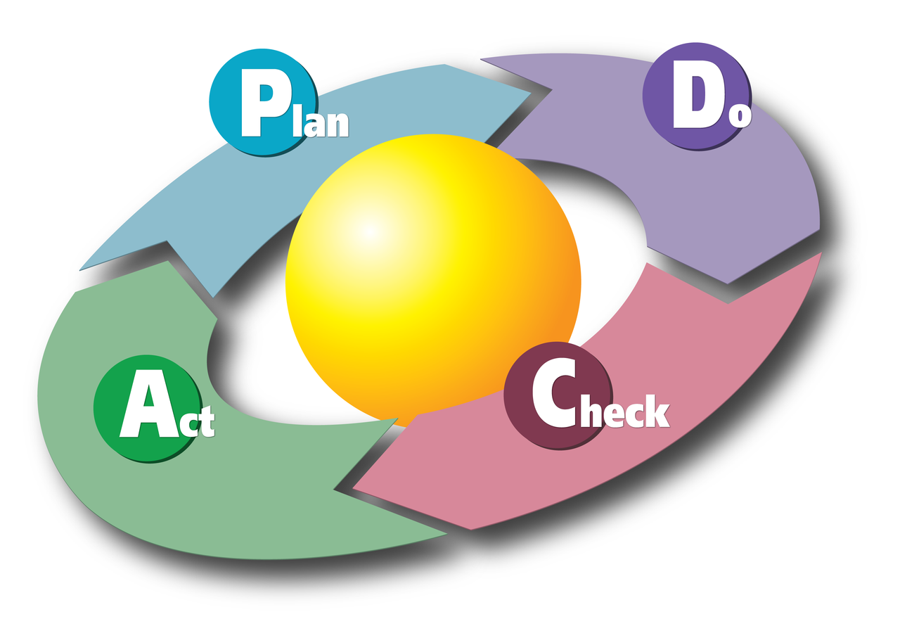
Sustaining Change – Lather, Rinse, Repeat!

Slide 31
Evolution
Maintaining the program
Competition
Reporting or analytics or research?

Slide 32

Program Maintenance
The more you build, the more time you need to spend maintaining dashboards, refreshing data, re-scoring, ….
Less time is available to build new insights
Provides opportunities to partner with IT on initiatives like a data warehouse and automated processes

Slide 33
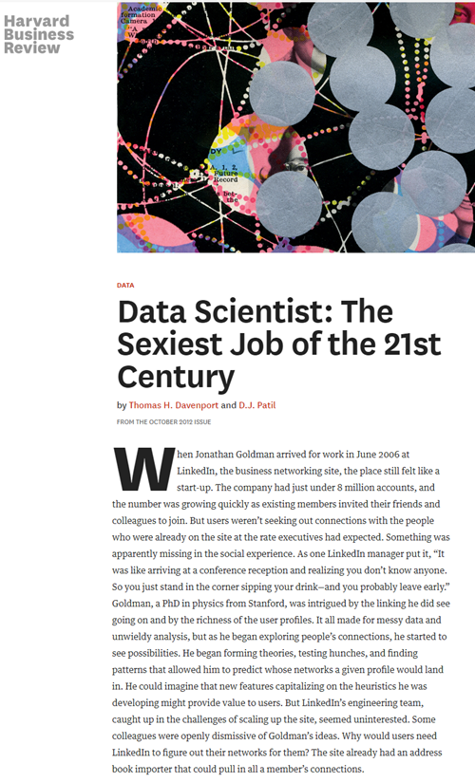
Competition
Huge change in the last 5 years…
All fundraisers now know that data analytics has a place in development
Data science is the flavor of the month and many people want to take the lead
If people see you as a consultant rather than a partner, other data analytics initiatives may pop-up

Slide 34
Reporting – Analytics - Research
What is the difference?
Where do you fit?
Who should lead?
How do you collaborate?

Slide 35
Lessons Learned
You can uncover the most amazing insights,
Produce the most innovative tools,
Develop the most accurate scores and ratings...
… And still fail to deliver value to your organization
The success of your data analytics program will 100% depend on your ability to facilitate the behaviour changes required so people work smarter to get better results
Change management builds the program

Slide 36
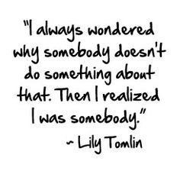

Questions?
Tracey Carmichael
Director, Research & Data Analytics
University of British Columbia
tracey.carmichael@ubc.ca
604-822-8808

