Slide 1
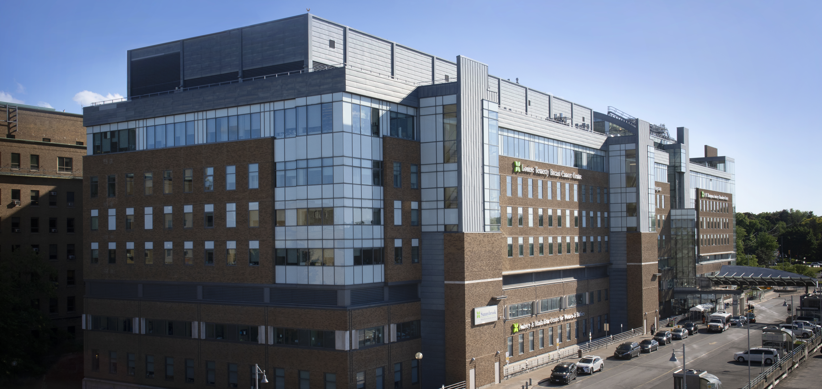

Using Data and Technology to Assist in Research and Fundraising
APRA CANADA CONFERENCE 2022
PRESENTED BY
Lauren Fulthorpe, Business Analyst
Mandana Fararia: Senior Manager, Analytics & Reporting
Lindsey Hutchison: Philanthropy Director
DATE
Thursday, October 27, 2022 (11:15am-12:15pm)
Notes:
Hello everyone! Thank you for attending this session on “Using Data and Technology to Assist in Research and Fundraising”.

Slide 2
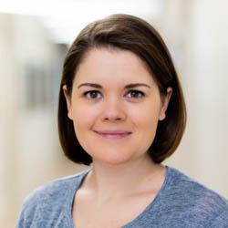
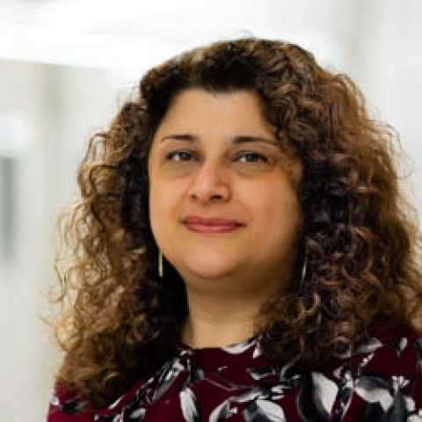
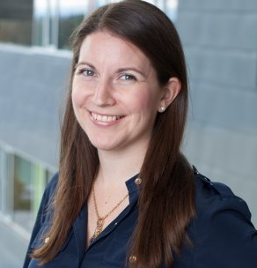
Oh, hello!
Lauren Fulthorpe Business Analyst (Former Prospect Management & Research Officer) | Mandana Fararia Senior Manager, Analytics & Reporting | Lindsey Hutchison Director, Philanthropy
Notes:
I’m Lori Cardillo, Manager of Research at the Sunnybrook Foundation and these are my colleagues, Mandana Fararia, Senior Manager, Analytics & Reporting and Lindsey Hutchison, Director, Philanthropy.

Slide 3
Agenda
Objectives & Goals
The Prospect Research journey
The Technology & Data journey
The Fundraiser journey
Review & Questions
Notes:
The three of us want to each share our unique perspectives on the journey the Sunnybrook Foundation went through working collaboratively to build capacity, increase philanthropic revenue and move towards using data driven reports to have a laser focus on philanthropy.
This will be our agenda for the session.

Slide 4

Let’s go on a journey together!
Notes:
Audience Engagement to be added: “How many of you have support from an information systems team/data visualization team” “Who here is from a small shop?” etc.
The Sunnybrook Foundation went from a manual driven shop to an automated fundraising shop and now have numerous click of a button reports the Research staff and the Philanthropy staff worked with Mandana and the data and technology staff to create. Now we have various automated reports which can be run and exported as needed
Mandana, Lindsey and I are each going to share our journeys and individual perspectives as a prospect researcher, technology/data person and as a fundraiser
We will each highlight how we transformed some of work to be automated and used data and technology to assist

Slide 5

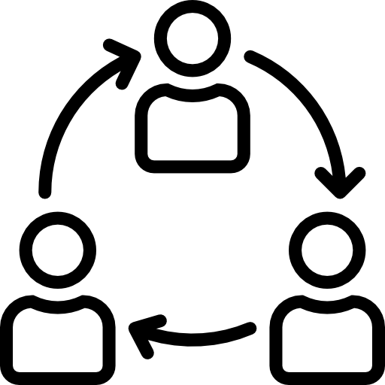


Objectives & Goals
Share best practice lessons learned | Demonstrate cross-functional collaboration | Show how data leads to better decision making | Show how investments in technology leads to growth
Notes:
As Prospect Research professionals, we all spend a lot of our time on prospect research, prospect identification and prospect management. Mandana, Lindsey and the Research Team have collaborated to use data and technology to create reports we all need to do our jobs more efficiently and faster
Research staff moved from manually creating Research Highlights and Research Briefs to auto generated reports. We still do full Research Briefs/Profiles as needed for the CEO or for transformational asks when extensive info is needed. But for the most part, Lindsey and the Philanthropy Team, run Research Highlights and Research Briefs to help with strategy and solicitations
Prospect Identification transformed from queries and data mining to self-serve and automated reports. We have a Daily Prospecting Report which generates all donations over a certain amount which are unassigned and also provides us with other info from the database such as if it’s a first time donation, cumulative giving total, last gift amount, gift date, neighborhood they live in and if it’s elite and even a Research Highlight if one has been entered
Prospect Management evolved from using queries to review and bringing up prospects in the pipeline that needs attention to leveraging the use of reports to move pipeline, forecast revenue and track fundraising progress against specific goals. Now Mandana has created numerous Power BI Reports to track this all and the data can be drilled down as needed. Mandana will speak to this more and provide examples later on in the presentation
Technology assisted a great deal to improve efficiency and allowing the organization to grow and have more time to work on proactive projects
Investments in technology lead to organizational growth

Slide 6



The Prospect Research Journey
Putting the end-users in the drivers seat
Then…
Manual and time consuming Research products Minimal reliance on reports and automation
Now…
Automated/Click-of-a-Button products
Notes:
Technology has changed how staff from Research and the Philanthropy Team work and work together
Data has provided opportunities which we can leverage to do our jobs better and ultimately raise more money
The business of fundraising has become so competitive that we need to focus on being more strategic and how to stay unique and remain competitive to reduce more dollars
Prospect Researchers are extremely knowledgeable information professionals, graduates of Master of Library Science programs, mature employees and have many years of experience
Based on these 3 factors, we need to stay advanced, continue using data and technology and not do so many things manually. The extra time we gain from automated reports, allows us to be more proactive in special projects

Slide 7
The Prospect Research Journey
Putting the end-users in the drivers seat
Research Highlights | A mini-biography on an assigned prospect (wealth indicators, career highlights, non-profit involvement); stored in the Notes tab in RE
Research Snapshot | Automated report that is populated with data from Raiser’s Edge (contact information, ratings, Sunnybrook connections and giving history, Research Highlights)
Notes:
Research Highlights and Research Snapshots were previously done manually by gathering info from Raiser’s Edge, databases and the web
Now we have automated, click of a button reports
Research Highlights includes a variety of key data on a constituent name which qualifies the name
Sunnybrook plans on adding $1 million+ donations and funding interests
Research Snapshot provides a high level overview on a constituent name from info which is populated in Raiser’s Edge in various fields
As we move forward towards a data driven culture, BI and analytics will become more and more important
The more data that is in the system, the better technology will be used for both these reports
Research Highlights and Research Snapshots are excellent reports for Philanthropy staff to run on their own
Research does provide full Research Briefs for complex files, solicitation meeting, transformational asks, meetings involving Board Mmbers, Physicians, etc.
This research info is also incorporated into other reports

Slide 8
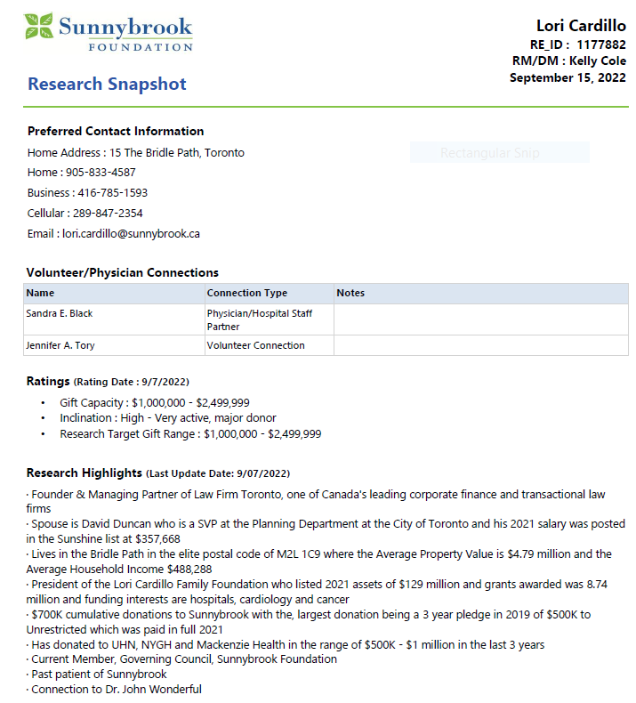
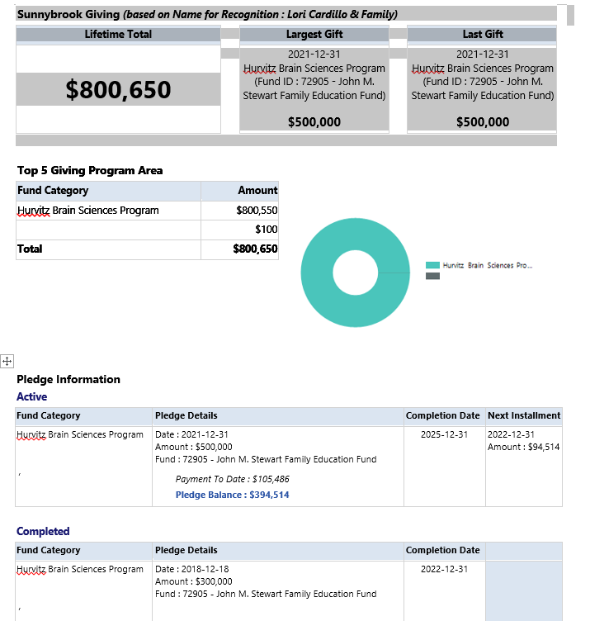
Notes:
This is an example of what a Research Snapshot looks like which is automated and all staff can run and don’t need to ask Research Staff for help
I used my own name and entered in some fictitious data to illustrate what a Research Snapshot looks like. I live in the Bridle Path, make loads of mone as a Managing Partner at a law firm, have donated million dollar gifts to other hospitals, etc.
Contains key info on the constituent:
- contact info - Volunteer/Physician connections - Ratings - info from the Research Highlights - summary of donations to Sunnybrook (largest gift, last gift, pledge info, etc.)

Slide 9
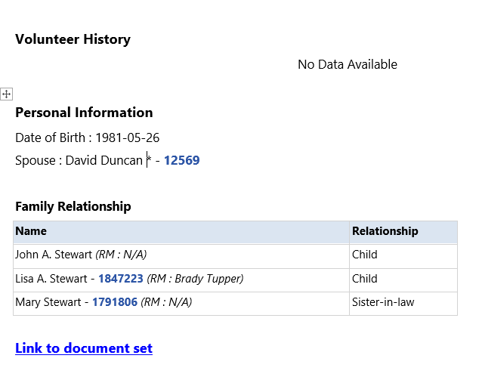

Slide 10


Prospect Research: Lessons Learned
Opportunity to focus on value-add services | More time to add data to systems | Opportunity to advance with technology | Communication and collaboration is key to success
Notes:
Greater capacity to focus time on value add services like in-depth Research Briefs for solicitation strategies on multi-million asks, prospect identification, qualification, etc.
More time to document research findings in the database for automated retrieval on reports (e.g. update employment positions, relationships, connections, funding interests, gifts to other organizations, wealth indicators, ratings, etc.)
Learn more about Power BI fundamentals and have a better understanding for the link between systems, reports and frontline fundraisers
Improve the role researchers can play as information professionals in data management
Now Mandana will share her experience from the data and technology computer scientist and report creator

Slide 11

The Technology & Data Journey
Bridging research and philanthropy through technology
Then…
Queries Data mining List building
Now…
Reports Data visualization (Power BI) Data warehouse
Notes:
Investment in Technology has been a challenge for many small companies specially non-profit sector
Small teams and limited budget is usually the driving force behind lack of technology in many of these organizations
When I joined Sunnybrook Foundation they already had an established technology team but not focused on data and Analytics. Self-serve and automated reports were not readily available to every team
Teams relied on different version of Raiser Edge queries which meant to provide the same dataset. The outcome, hours spent on data reconciliation, manual processes needed to achieve this
We started assessing the current state and identified gaps and area for improvement. We heavily relied on our existing infrastructure and made use of previous investments in technology, tried improving where possible otherwise upgraded the system. New dedicated BI server and optimized processes for data synchronization is to name a few as the result of this exercise
Using Data warehouse as the source of the truth and building up the new automated reports and visualizations after
Established data quality processes for new reports. Resolving data quality issues and where they are stemming from was a crucial step. We had to compare data output from an automated report vs its manual version and find the root cause for the difference. This created confidence in our product and services as we had an answer when there was a question on discrepancies
Finally we started moving to visualization to make our data a story. Leveraging Power BI as a platform to create dashboards and drill-through to details where needed

Slide 12
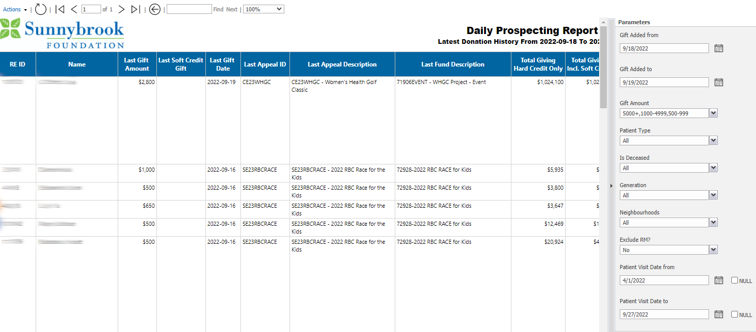
Notes:
This report gives an overview of prospects that donated within timeframe selected in the report
Research team uses this report on a daily basis to monitor the new gifts which meets specific criteria for them. Additional filters can be applied to limit the results to specific donors

Slide 13
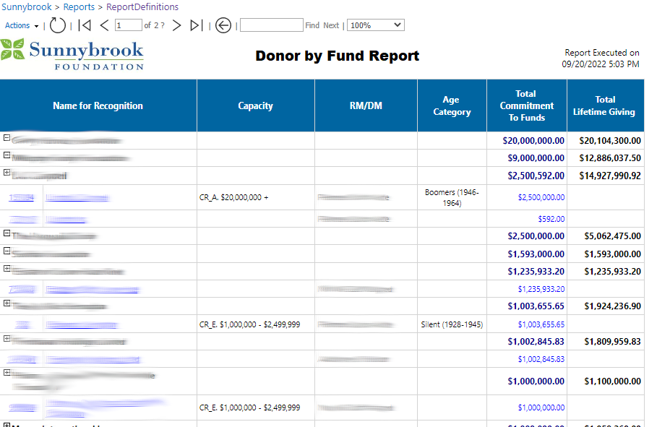
Notes:
This report provides the giving summary and commitments by selected fund (in report parameter).
We use name for recognition to group the related donors in one record

Slide 14
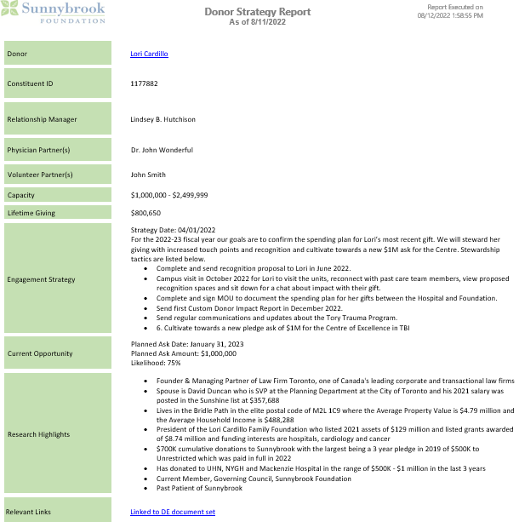
Notes:
This report serves as briefing summary for donor and is being used by executive team and fundraiser to get a quick summary about donor.
Note: ask Lindsey about the use case

Slide 16


Technology & Data: Lessons Learned
Collaboration supports data driven decisions | Data literacy and data quality is key to success | User engagement is crucial for report design and adoption | Understand and adapt to stakeholder needs
Notes:
We gained actionable insights into our business by leveraging subject matter expertise on business data
We learned that only having strong analytics team and products is not the success key, we need everyone across our teams to understand the data, trust it and be able to utilize it
Only through user engagement we get to provide what they truly need. Can’t make assumptions and apply the technical knowledge
Data and technology evolve and so do people, we need to take an iterative approach to our engagement. Delivering data in not the final state, we need to keep re-examining it to ensure it still meets the need based on current organization's settings

Slide 17
The Fundraising Journey
Leveraging data and technology for results
Then…
Manual and time consuming query pulls Tracking in spreadsheets
Now…
Turning to data and technology to support business decisions and moving the pipeline through the solicitation cycle
Notes:
Good morning everyone
It’s my turn now to speak to my experience as a fundraiser levering data and technology for fundraising results. And let me tell you, it’s been a journey.
For many fundraisers, their skills lie in the realm of relationship building and not always in the realm of data and analytics
I have a question for your all: Who in the session today has worked with a fundraiser who failed to update their call notes after a meeting or update a prospect’s status in the system? Hands up, virtual or in person. Can I get one person to share how that impacted your work…
I will raise my hand and say I’m guilty of this myself.
Now for most fundraisers there is a lot of pressure to spend your time on front facing donor activity, rather than back of house data coding and reporting.
If the queries to manage pipeline activity are too complex or time consuming to pull, I know many a fundraiser who will resort to using a spreadsheet to log and capture their activity rather than putting it in the system.
When it becomes the Philanthropy’s job to pull their pipeline updates and that can be viewed in real-time by leadership, there is a real incentive to properly enter your activity in the system. At Sunnybrook as you’ve seen in the other presentations, we’ve moved to using automated reports and Power BI to give management and leadership real-time access to the information in the system. And these reports are easy to pull!!
For the Philanthropy team, that means we actually use the data from the system regularly to support our business decisions, to prompt donor activity and to fuel revenue generation. It’s not perfect, but it’s far more turn key and user driven than any other place I’ve worked.
For example the Research Snapshot report that Lori showed you earlier. When myself or our CEO is going to meet with a board member of senior volunteer, we pull the research snapshot as part of the briefing materials for the meeting. We know that giving activity and volunteer engagement are both tracked in Raiser’s Edge and the Research Highlights are refreshed regularly for this group, so rather than having to constantly request Research Brief Updates, we get the real time information needed.
Another question: Who in room feels a wave of panic when they get a rush request from a fundraiser for an on the fly or net new research brief? Hands up. Has it ever happened that then you receive no response back from the fundraiser on how the prospect strategy was moved forward by your work? So this is another crime I can say guilty as charged to.
But with the systems we’ve developed at Sunnybrook, like the Donor Strategy Report that Mandana shared, we’re breaking down this disconnect. When I’m meeting with other members of the team (our stewardship officers, communications staff, or a physician hospital partner) I can pull this to take to my meeting or share in advance so everyone has documentation of the donor, including capacity and research highlights. Then we go in and update our strategy note after the meeting, so the research team has access to see what our next planned actions are. The manual back and forth of rush requests between research and philanthropy has been reduced. This was a report that Mandana and I worked to co-design the fields in, to really meet team needs.

Slide 18
ADVANCEMENT PORTFOLIO STATUS REPORT
Relationship Manager | Prospect Segment | Constituent ID | Full Name | Amount Asked | Date Asked | Amount Expected | Likelihood | Funding Area | Days Since Discovery Assignment | Days In Cultivation | Days In Solicitation | Days Since Last MG Action
Hutchison | Active Prospect | 1756789 | xxx | $500,000 | 2023-10-01 | $250,000 | 50% | Burn |  |  |  | 16
Hutchison | Active Prospect | 2053581 | xxx | $250,000 | 2022-04-14 | $100,000 | 50% | Brain - GHBSC Building Match |  | 75 | 167 | 40
Hutchison | Active Prospect | 84625 | xxx | $200,000 | 2022-06-23 | $200,000 | 75% | Burn |  | 90 |  | 64
Hutchison | Active Prospect | 409274 | xxx | $3,850,000 | 2020-12-09 | $3,850,000 | 75% | Capital Projects |  | 448 | 65 | 6
Hutchison | Active Prospect | 2076330 | xxx | $50,000 | 2023-09-15 | $25,000 | 50% | Tory Trauma |  |  |  | 14
Hutchison | Active Prospect | 580790 | xxx | $5,000,000 | 2022-12-01 | $2,500,000 | 50% | Tory Trauma |  |  |  | 5
Hutchison | Active Prospect | 1057628 | xxx | $150,000 | 2021-11-17 | $150,000 | 50% | Tory Trauma |  | 264 |  | 236
Hutchison | MG Donor | 1672859 | xxx |  |  |  |  |  |  |  |  | 13
Hutchison | MG Donor | 1570571 | xxx
Hutchison | Discovery | 1117447 | xxx |  |  |  |  |  | 5
Hutchison | Discovery | 106602 | xxx |  |  |  |  |  | 5
Hutchison | Discovery | 96453 | xxx |  |  |  |  |  | 37 |  |  | 796
Hutchison | Discovery | 2275297 | xxx |  |  |  |  |  | 19 |  |  | 12
Notes:
Beyond research briefs, there are some key reports we are also using to manage pipeline.
This pipeline report is a click-of button report generated from Raiser’s Edge using our Data Warehouse
The prospect segment column is generated based on logic to categorize my donors by active prospect, Major Gift donor or discovery.
The blue columns pull in data from the Prospect Tab in Raiser’s Edge for those donors who are in active solicitation.
I can use this report to prompt my own activity or evaluate prospect movement for someone I manage.
The same metrics are pulled into a Power BI dashboard that we run for the whole team, which I’ll now show you on the next slide.

Slide 19
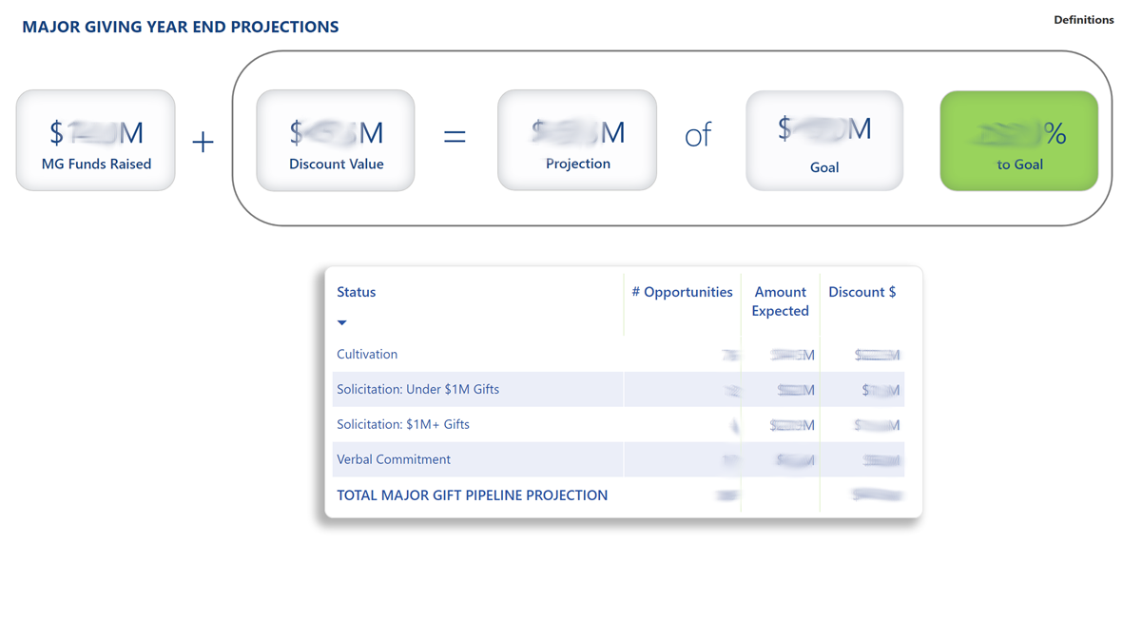
Notes:
This report that we view in Power BI, which is a cloud-based data visualization tool, takes all of the proposal data from Raiser’s Edge and combines it with gift data.
The report allows us the team to evaluate if we have the correct number and value of asks; combined with revenue received, to meet our annual goal.
The chart at the bottom divides the proposals in the system by proposal status and each value is weighted differently; for example for verbal commitments we use the full value, but for solicitations, we’re using a discounted value based on likelihood of proposal acceptance.
The chart at the bottom has the option for us to drill through and view the pipeline with detail, in the format similar to what was on the previous slide.
This means that we can actively monitor how long it’s taking the team to move through solicitations, or go from a verbal commitment to signed gift agreement.
Especially at the end of the fiscal year, this is a report leadership views on the daily.

Slide 20
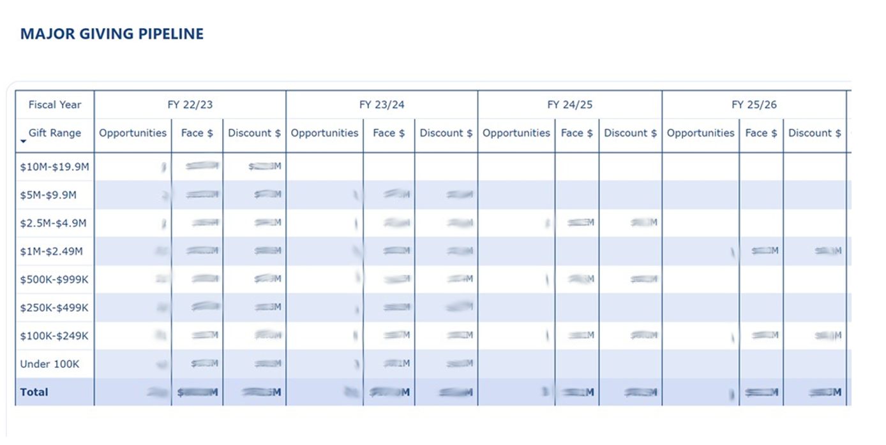
Notes:
We also have a report in Power BI to look at Major Gift Pipeline projections.
This report pulls proposal data from Raiser’s Edge based on fiscal year of gift expected.
It helps our team to project out how we are doing at ensuring we have a sustainable pipeline for future years and stratifies the data by gift level.
This report is great for business planning, because it can then prompt our fundraising team to go back to research and say help us identify prospects with capacity at a certain giving level.
It’s also a strong motivator for our fundraisers to think about renewal and enter in future oriented proposal data for prospects and donors beyond the current fiscal year.

Slide 21


Fundraising: Lessons Learned
Shift from manual to system automation | Empower end-users to leverage data and technology | Working collaboratively leads to success
Notes:
The reports I’ve shown today have helped shift me in my own personal practice to rely more on data entered in our constituent database than on stand alone spreadsheets.
The reports are easy to pull, they’re not in a system like Crystal that I don’t know how to use and they are updated in real time, rather than a monthly or quarterly basis
Working with Mandana and Lori we’ve adapted some of these tools over time to best serve our team, and I’m certain they will continue to evolve and change in the future.
It’s been an exciting part of my career development at Sunnybrook to be engaged with the Knowledge and Systems team to provide end-user feedback on our reports, and to receive training so me and my team members are confident on how to pull the reports.
I really see that these tools are contributing to a more data driven fundraising culture at Sunnybrook and are helping to keep the Philanthropy team on task for success.

Slide 22

Final Thoughts
Technology has supported the collaboration between the Research team and Philanthropy team | Fundraising is still about human interaction; technology can leverage it, but not replace it

Slide 23
Questions?

Slide 24
Our contact information
Lauren Fulthorpe Business Analyst lauren.Fulthorpe@sunnybrook.ca | Mandana Fararia Senior Manager, Analytics & Reporting mandana.fararia@sunnybrook.ca | Lindsey Hutchison Director, Philanthropy lindsey.hutchison@sunnybrook.ca

Slide 25
Thank You

