Slide 1
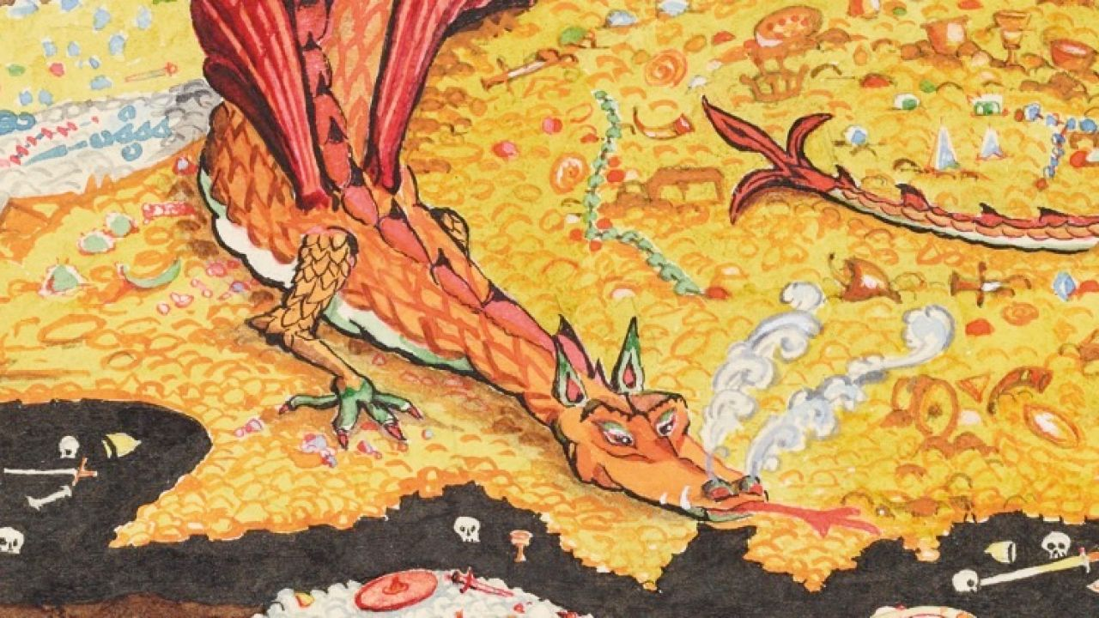
How to train your Fundraiser
The Power of Partnership – Using Strategic Prospect Research to Drive Fundraising Strategy
Presented by:
Jennifer Maddock - Manager Prospect Research, WCHF
Megan Skyvington, CFRE - Director, Philanthropy – Corporate Giving and Partnerships, WCHF
Notes:
Point one
The framing
Who is our hero – the Prospect researcher – Misunderstood hero
What is not working
PR – isolating, lonely, misunderstood, very specific and narrow traditionally
Seen as non-fundraiser, instead info gatherer

Slide 2

Introducing – Jenn and Megan!

Slide 3

Framing for today - Who is our hero?
Language choices for today
Yes, we are using Lord of the Rings to make our case
Yes, we are open to using additional Fantasy/
Sci-fi references as needed

Slide 4
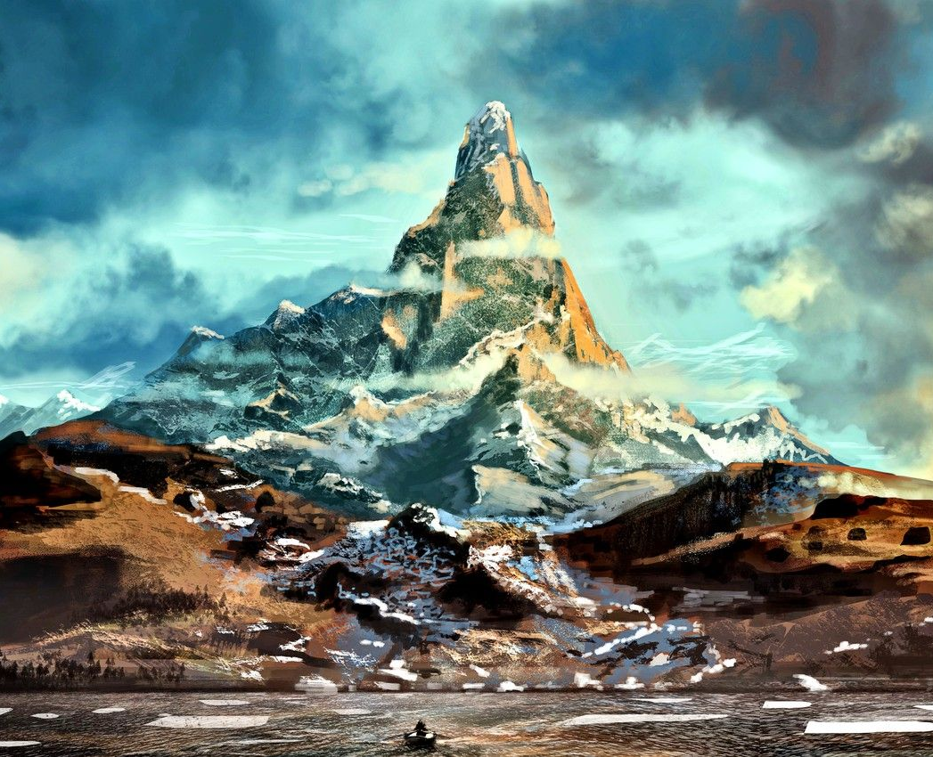
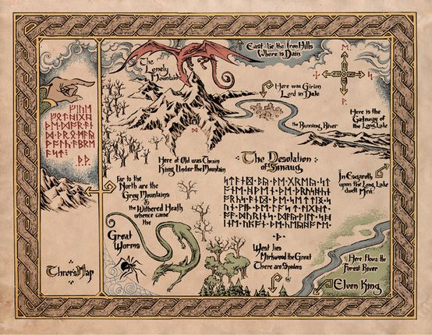
The hero’s journey – THE QUEST
Notes:
Hobbiton
Not allowed to venture out… also not in our nature
Empowering, not empowered to venture out to be involved in strategy and this is how PR is utilized by frontline fundraisers
Result is that this leads to orgs not understanding the value that PR can bring – what makes the Hobbits important
But… underneath there is a wealth of opportunity and the core to unlocking that is partnership. And PR role does not have to be very senior to make a huge impact (titles do not limit you). It’s reframing the thinking, what we ask of PRs and how we engage in their information – maybe it’s also how we train PRs (they are not administrators).
Making them a true partner unlocks their full potential – and that means not keeping them on the sidelines.

Slide 5

How to venture out:
THE PATH
Notes:
How to find the way….what if you are a small shop? Only one PR?
NO PROBLEM! You don’t have to do this alone.
Start small- reach out to your manager/director and colleagues.
Understand what is expected of your role- PR tend to often be in a “catch all” space within fundraising
ASK QUESTIONS!! BE PERSISTENT
How is my work being used?
What sorts of information are you looking for?
What are you hoping to learn?
Can I be part of the briefing meeting/discussion?
Can you let me know how the meeting went?

Slide 6
Ask Questions, be persistent!
Notes:
How to find the way….what if you are a small shop? Only one PR?
NO PROBLEM! You don’t have to do this alone.
Start small- reach out to your manager/director and colleagues.
Understand what is expected of your role- PR tend to often be in a “catch all” space within fundraising
ASK QUESTIONS!! BE PERSISTENT
How is my work being used?
What sorts of information are you looking for?
What are you hoping to learn?
Can I be part of the briefing meeting/discussion?
Can you let me know how the meeting went?

Slide 7
How is my work being used?
What sorts of information are you looking for?
What are you hoping to learn?
Can I be part of the briefing meeting/ discussion?
Can you let me know how the meeting went?
(Did we miss any questions?)
Notes:
How to find the way….what if you are a small shop? Only one PR?
NO PROBLEM! You don’t have to do this alone.
Start small- reach out to your manager/director and colleagues.
Understand what is expected of your role- PR tend to often be in a “catch all” space within fundraising
ASK QUESTIONS!! BE PERSISTENT
How is my work being used?
What sorts of information are you looking for?
What are you hoping to learn?
Can I be part of the briefing meeting/discussion?
Can you let me know how the meeting went?

Slide 8
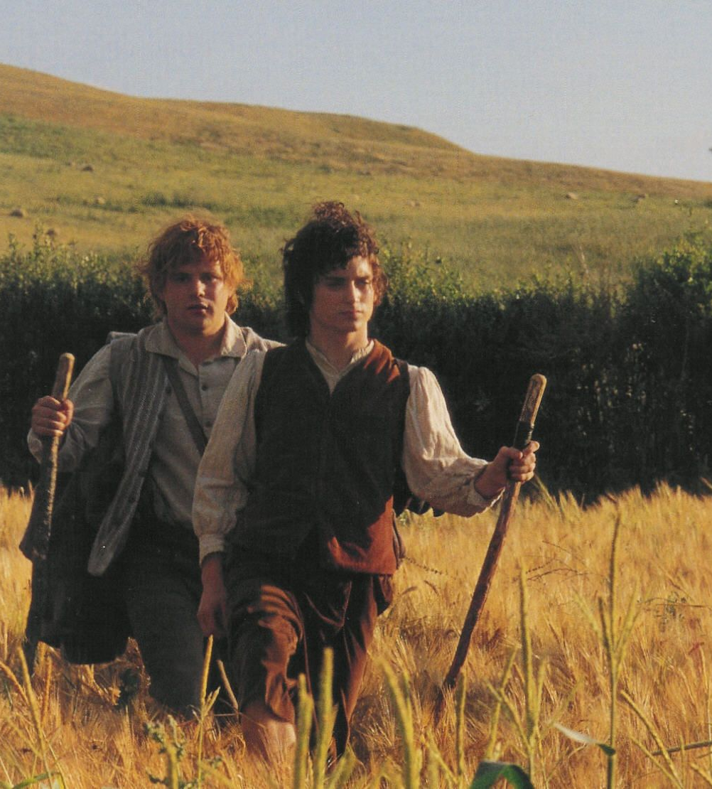

What happens when we venture out?
…into the big wide world with all you yucky extroverts.
Notes:
How do conversations sound across teams? Who is doing the talking (power dynamic ack)
What questions are being asked?
Looking for the ways research, data work can be used to drive and underpin fundraising strategy (vs. information gathering alone and leaving it to others to determine strategy alone)
Conversation changes from “who is this person” to “why would they give to us/ be involved” – this stretches thinking and skill sets
This is the great re-framing.
This requires trust AND enhanced respect for your PR
Finding your people and place

Slide 9
How do conversations about donors sounds across your teams?
Who is doing most of the talking?
Re-framing the work - the ‘why’
Moving from “who is the person /do they have capacity?” to “why would they be interested in supporting us/ be involved?”
Notes:
Hobbiton
Not allowed to venture out… also not in our nature
Empowering, not empowered to venture out to be involved in strategy and this is how PR is utilized by frontline fundraisers
Result is that this leads to orgs not understanding the value that PR can bring – what makes the Hobbits important
But… underneath there is a wealth of opportunity and the core to unlocking that is partnership. And PR role does not have to be very senior to make a huge impact (titles do not limit you). It’s reframing the thinking, what we ask of PRs and how we engage in their information – maybe it’s also how we train PRs (they are not administrators).
Making them a true partner unlocks their full potential – and that means not keeping them on the sidelines.

Slide 10
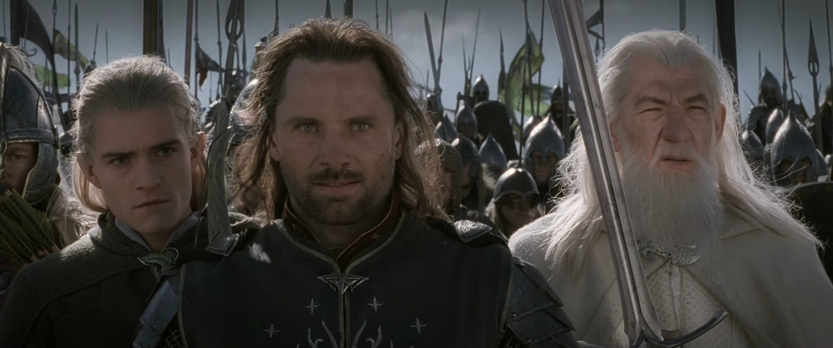
What does the other side think…the yucky extroverts
Notes:
How do we encourage team members to participate and engage with strategic thinking?
Stop talking. You need to BE QUIET and ask more questions.
Ie. What are you seeing that I’m not?
What do you think I’m missing?
What does this profile tell you?
Where would you focus their attention (priorities to focus on?)
Don’t presume you can do the PRs job. You can’t and you don’t want to.
Show some respect - recognize strength and skill.
See how you complement one another as a team.
Ask each other – what more can we do and explore together.
Engage in creative brainstorming, asking what ifs? This can be messy work without firm answers and that’s ok! Be wrong.
Have some fun! This is interesting work, and you are talking to the experts on donors!

Slide 11
What are you seeing that I’m not?
What do you think I’m missing?
Thank you for this work, what does this profile tell you?
Where would you focus this prospect’s attention?
What would you imagine is important to this person?
Be quiet. Make space. Ask questions before delivering your thoughts. Fundraising is a team sport!
Shhh…
Notes:
How do we encourage team members to participate and engage with strategic thinking?
Stop talking. You need to BE QUIET and ask more questions.
Ie. What are you seeing that I’m not?
What do you think I’m missing?
What does this profile tell you?
Where would you focus their attention (priorities to focus on?)
Don’t presume you can do the PRs job. You can’t and you don’t want to.
Show some respect - recognize strength and skill.
See how you complement one another as a team.
Ask each other – what more can we do and explore together.
Engage in creative brainstorming, asking what ifs? This can be messy work without firm answers and that’s ok! Be wrong.
Have some fun! This is interesting work, and you are talking to the experts on donors!

Slide 12
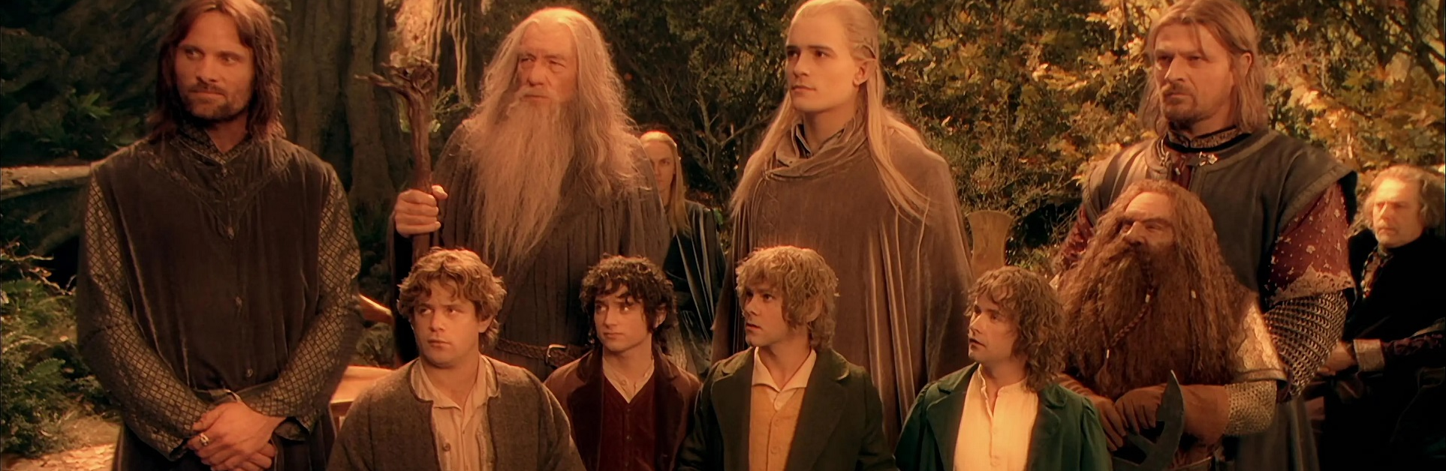
How do we unite the Fellowship?
So, you’ve found your people. Now what?
Notes:
How do you structure meetings/ how often do you meet?
Who does the work?
Ack. How the PR work is being used – reporting back and updating information. The information vortex is real.
Enhance communications
FR – who do you touch base with when something is going well/ post meeting
Do you reflect this in a call report – giving credit, touching base personally (quick call), how do you ack and shout out to the data and research?
Who drives strategy – big strategy vs. file-by-file basis – give real time Women’s examples
Ex. PR being empowered to lead moves management meetings and giving space for that leadership and direction
+ taking this direction and advice (regardless of rank) b/c then we truly remove barriers and fear around sharing information

Slide 13
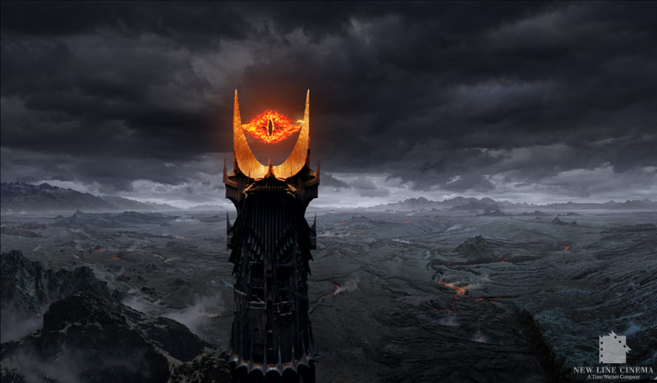
Battle the Information Vortex!
Enhance your communications!
Stay Accountable!

Slide 14
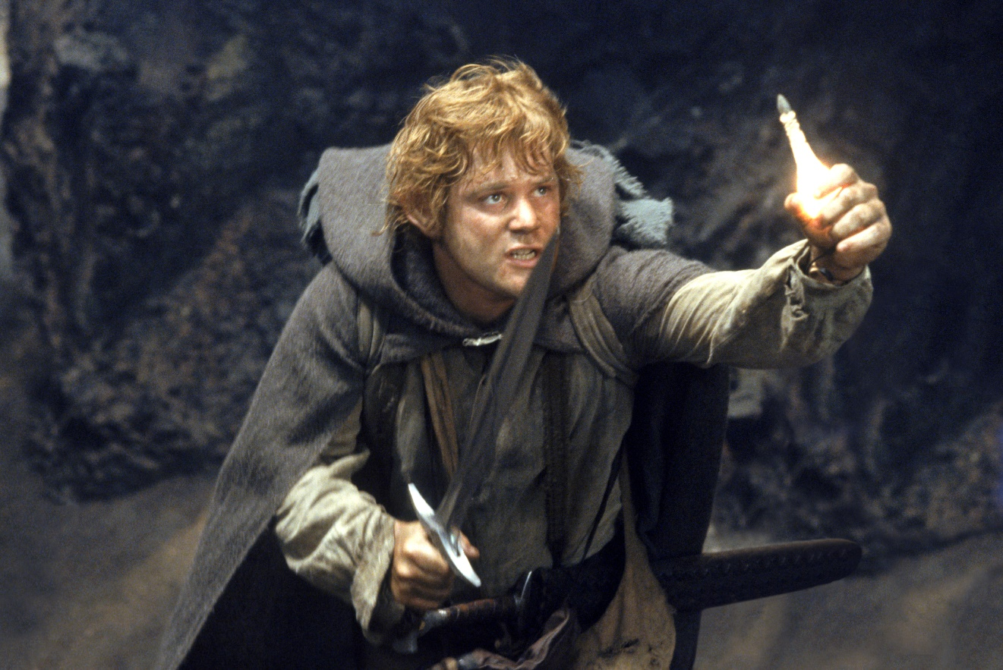
Case Study Time!
Notes:
Both scalable (produce takeaways and learnings for each one)
Strategy Example (different from straight information gathering)
Mining
Still information gathering
Sector scan + prospect list developed
Crash course with partner on flags
Brainstorm on framing (FR know programs very well)
Meeting with volunteers (FR)
Report back
Ongoing work / shared accountability (communications)
Process Examples
Moves Management – Transformational Gift List @Women’s
Super focused
Enhanced rigour
Fluid process (changes every week)
Drives activity + requires shared accountability and communication

Slide 15
Hands-on examples:
Informing Strategy:
Sector Scans – ex. Mining + developing prospect lists
Opportunities:
Flagging concerns (framing asks)
Brainstorming opportunities
Meeting with Volunteers (amplify the research)
Reporting back
Ongoing work/ shared accountability
(we are all fundraisers!)
Notes:
Both scalable (produce takeaways and learnings for each one)
Strategy Example (different from straight information gathering)
Mining
Still information gathering
Sector scan + prospect list developed
Crash course with partner on flags
Brainstorm on framing (FR know programs very well)
Meeting with volunteers (FR)
Report back
Ongoing work / shared accountability (communications)
Process Examples
Moves Management – Transformational Gift List @Women’s
Super focused
Enhanced rigour
Fluid process (changes every week)
Drives activity + requires shared accountability and communication

Slide 16
Process examples:
Moves Management
Transformational Gift List @Women’s
Staying focused
Enhanced rigour
Fluid processes/ allowed to change week to week when needed
Process must always drive activity!
Notes:
Both scalable (produce takeaways and learnings for each one)
Strategy Example (different from straight information gathering)
Mining
Still information gathering
Sector scan + prospect list developed
Crash course with partner on flags
Brainstorm on framing (FR know programs very well)
Meeting with volunteers (FR)
Report back
Ongoing work / shared accountability (communications)
Process Examples
Moves Management – Transformational Gift List @Women’s
Super focused
Enhanced rigour
Fluid process (changes every week)
Drives activity + requires shared accountability and communication

Slide 17
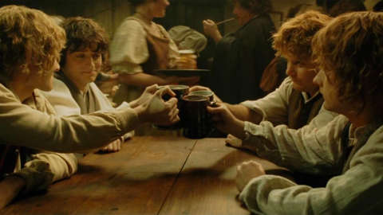
Ideal State

Slide 18
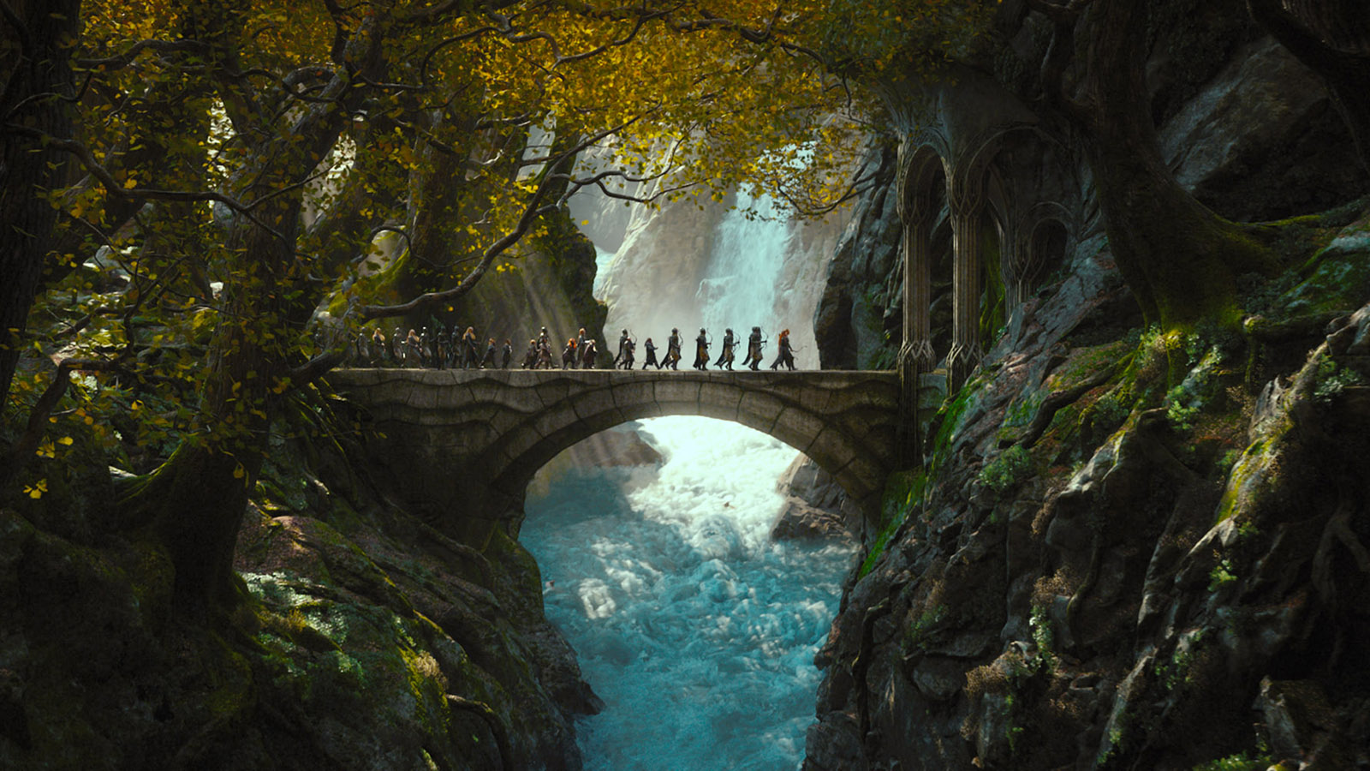
Thank you!
Questions?
Shared experience?

