Slide 1

Leveraging Data and Analytics to Find the Transformational Donors in your Database
Jessica Diniz
Chief Development Officer
JDRF
Jennifer Robins, MBA
Director, Business Development – Not-for-Profit Lead
Environics Analytics

Slide 2
Land Acknowledgement
We acknowledge the land of where our head office resides is the traditional territory of many nations including the Mississaugas of the Credit, the Anishnabeg, the Chippewa, the Haudenosaunee and the Wendat peoples, and is now home to many diverse First Nations, Inuit and Métis peoples. We also acknowledge that Toronto is covered by Treaty 13 with the Mississaugas of the Credit.

Slide 3
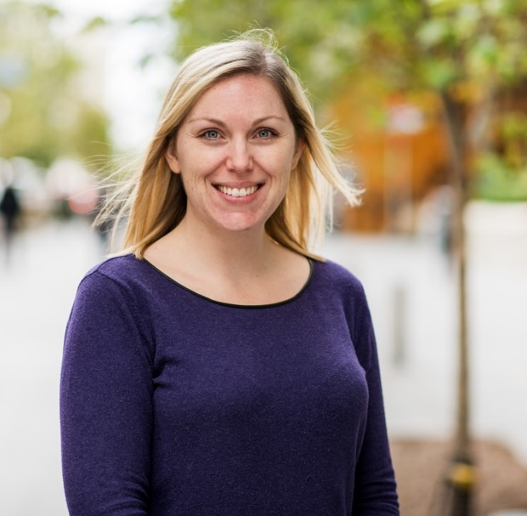

Today’s Presenters
Jennifer Robins, MBA
Jessica Diniz
Director, Business Development
NFP Lead
Chief Development Officer
JDRF

Slide 4
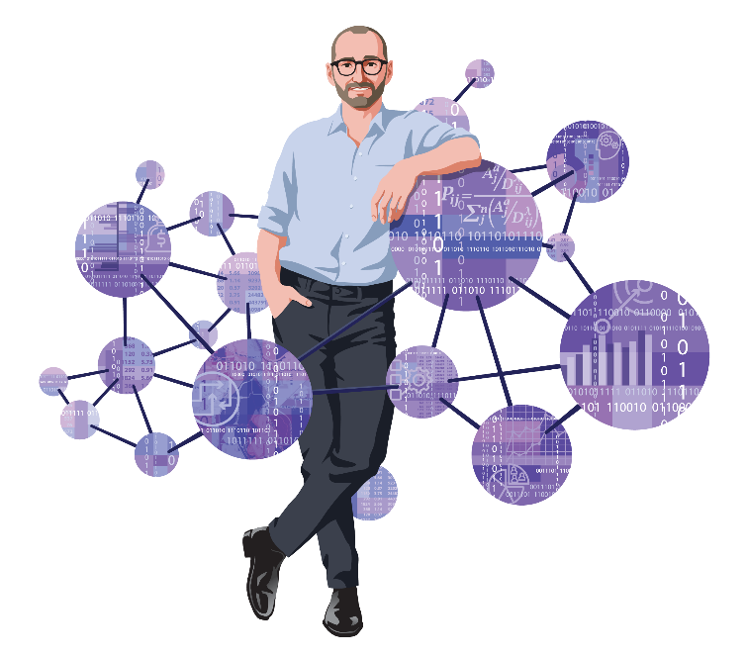

Webinar Agenda
About WealthScapes
The Financial State of the Nation
Building Your Prospect Pipeline
Key Take Aways

Slide 5
WealthScapes 2022

Slide 6

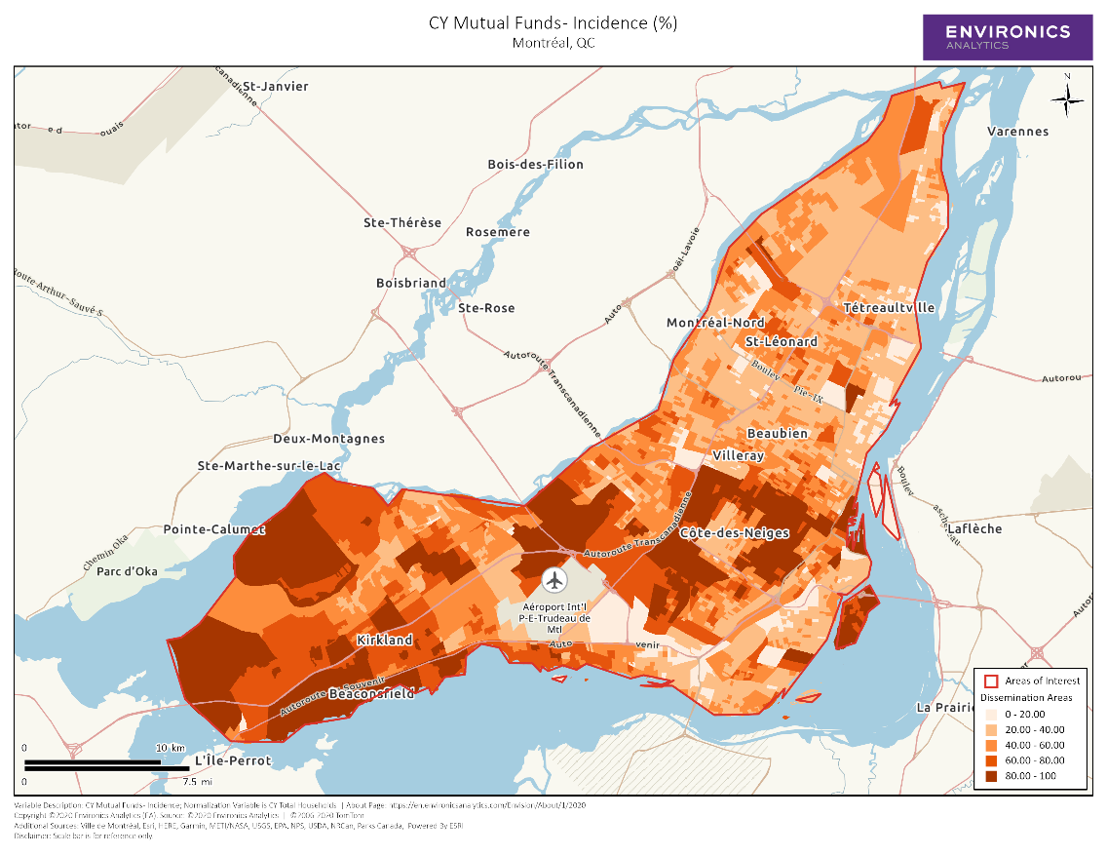
An Introduction to WealthScapes
WealthScapes is the most comprehensive database available on the assets, liabilities and income levels of Canadians
Built using sophisticated modelling techniques and controlled with data from authoritative sources such as the Bank of Canada, Canada Revenue Agency, Ipsos, Teranet-National Bank, Equifax and Statistics Canada
Features key financial and investment statistics showing market share and share of wallet
Helps financial institutions, charitable organizations and large retailers gain a better understanding of the financial and investment behaviour of their customers
These data points can be appended to constituent records at a postal code level
Notes:
Wealthscapes, which we at EA have been producing annually for the past fourteen years, is Canada’s most comprehensive commercially available database of household assets, debt and income.
Available down to the neighbourhood level, we produce estimates of balances and incidence of 38 categories of assets and liabilities using state of the art modeling techniques together with the most current and authoritative data from sources such as the bank of Canada, statistics Canada and Equifax.
WealthScapes can be used to generate insights across multiple sectors, such as financial institutions, charitable organizations , large retailers and government agencies. In the latter parts of the presentation Jennifer Robbins will show.. And XX will dive deeper into a case study.. Etc.
It has helped marketers from a wide range of firms including financial institutions, charitable organizations , large retailers and government agencies
WealthScapes includes an additional historical year of data, allowing users to understand how market and demographic shifts have impacted their target audience

Slide 7
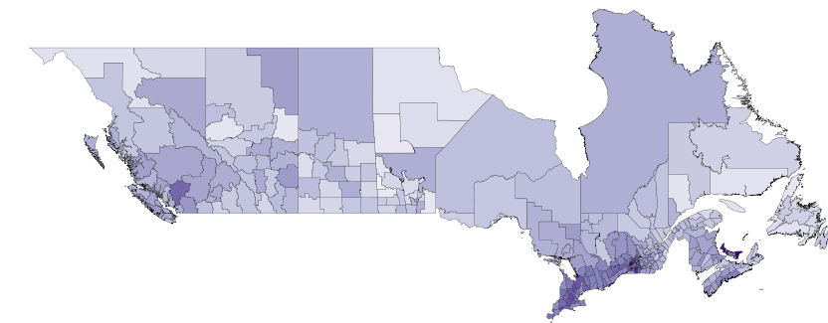
Macro Meets Micro
Statistics Canada National Balance Sheet Accounts
WealthScapes
CRA Tax Data
Equifax Debt Data
Financial Survey Data
Teranet-National Bank House Price Index Data
Notes:
As mentioned previously, wealthScapes is built using data input from a wide variety of sources. The model takes the authoritative macroeconomic estimates of total household wealth published by Statistics Canada’s Macro-economic accounts and assigns each dollar down to the neighbourhood level.
We do this by looking to multiple sources of micro-economic data, such as neighbourhood level aggregate income tax data from CRA and debt data from Equifax; two financial surveys, the Survey of Financial Security by Statistics Canada and the Canadian Financial Monitor by Ipsos, and up to date house Price index data, to name a few.
Multiple types of statistical and optimization techniques are used to combine all this data together and ultimately produce WealthScapes.
At Environics we are constantly striving to keep our models state-of-the art by introducing new data sources and techniques as they become available. This year we made several model enhancements including
Extending the asset and debt coverage by leveraging the statistics available through the household macroeconomic accounts published by statistics canada
Adding new assets and liability breakdowns to the variable list, and
Incorporating new higher resolution data from CRA
238

Slide 8
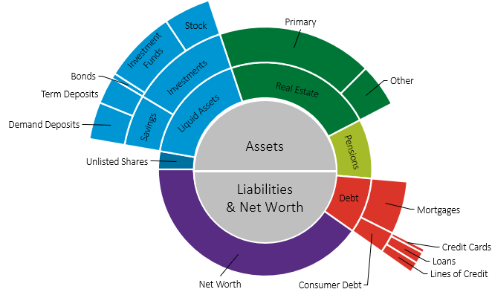
Six Dimensions of Household Wealth
Canadian Household Assets, Debts and Net Worth
Notes:
Before getting into details, lets get a high level look at net worth as it is published in WealthScapes. Wealthscapes is composed of both assets and liabilities as seen in the chart presented.
The asset side of the household balance sheet is broken down into 4 main components – Unlisted shares, Liquid assets, real estate and pensions. Real estate is the largest contributor to net worth with the majority of that balance coming from household’s ownership of their primary residence. For Liquid assets, most of the money is allocated to investments such as stocks, bonds, and funds but Canadian households also keep a sizeable portion of their assets in chequings and savings accounts.
In terms of liabilities we can see that mortgage debt is by far the largest slice, followed by loans and lines of credit, with only a sliver coming from credit card debt.
This year we added 3 new categories to the product. In dark blue, unlisted shares, otherwise known as private equity, is the only new addition visible on this chart. Although it is considered to be a financial asset, since unlisted shares are generally illiquid, the new category has been kept separate from the other more liquid financial assets.
The remaining two additions are not shown on this chart - the first is ETFs, or Exchange Traded Funds. The broad category ‘investment funds’ visible in the top left corner is further broken down in wealthscapes into mutual funds and segregated funds. Previously EFTs were contained within the mutual fund category but with the latest vintage we separated out ETFs and traditional mutual funds.
The final new category is Home Equity Lines of Credit or HELOCs for short which are contained in the secured line of credit sub-category of lines of credits. Now secured lines of credits are broken down into helocs and other secured lines of credits. HELOCs comprise the majority of the balance in the secured line of credit category.
440

Slide 9
Distribution of Financial Assets
Notes:
**Donors care where is the money while mission side looking to locate vulnerable populations, aka hugely diverse city like Toronto they can be stone’s throw away)
Last year we re-built from the ground up the guts of the financial assets portion of wealthScapes. Every neighbourhood in wealthScapes is composed of a set of households and getting an accurate distribution of wealth across those households is very helpful especially in diverse neighbourhoods where the average does not reflect the true mix. Here is a snapshot of the distribution we got this year for the financial assets of the households of Canada. We can see that the top 5% of households have over half the financial assets and wealthscapes can help you find the neighbourhoods in which these households live.
515

Slide 10
Key Trends from 2021 and early 2022
It’s been a wild ride!

Slide 11
Market Trends

Slide 12
Average Canadian Household Balance Sheet
Canadian Average Value and Growth Rates per Household

Slide 13
Net Worth Increases Across Canada
Net Worth per Household
24.0% | 30.2% | 48.8% | 24.8% | 15.3% | 24.3% | 18.9% | 22.3% | 39.5%
23.5% | 18.5% | 27.6% | 17.1% | 24.3% | 19.4% | 11.8% | 10.4% | 24.4%
Southwestern Ontario is defined as the five CMAs of Hamilton, London, Kitchener - Cambridge - Waterloo, St. Catharines - Niagara, and Windsor

Slide 14
Real Estate In Depth
Real Estate Value per Holding Household
28.8% | 27.9% | 16.9% | 17.3% | 18.8% | 31.7% | 29.8% | 34.2% | 23.3%
27.7% | 29.0% | 23.9% | 27.7% | 17.9% | 16.2% | 19.8% | 21.4% | 40.0%
Southwestern Ontario is defined as the five CMAs of Hamilton, London, Kitchener - Cambridge - Waterloo, St. Catharines - Niagara, and Windsor

Slide 15
Average Household Incomes
1.1% | 3.3% | 0.9% | -1.0% | -0.9% | 1.0% | 1.9% | -3.2% | 1.2%
1.6% | 2.0% | 3.9% | 1.4% | 0.9% | 1.1% | 1.8% | -7.1% | 0.6%
Southwestern Ontario is defined as the five CMAs of Hamilton, London, Kitchener - Cambridge - Waterloo, St. Catharines - Niagara, and Windsor

Slide 16
Real Estate 2021 vs. Q1 & Q2 of 2022
Real Estate Value per Holding Household
-4.8% | -2.2% | 13.9% | 11.2% | 1.2% | -10.9% | -0.1% | -3.0% | 0.4%
-11.7% | -0.1% | -2.2% | -5.5% | 15.1% | 13.3% | -10.6%

Slide 17
Debt to Disposable Income Up
Debt to Disposable Income
7.9% | 10.3% | 1.5% | 2.5% | 16.9% | 10.3% | 2.4% | 15.7% | 36.8%
10.6% | 2.9% | 9.8% | 9.5% | 0.9% | 3.0% | -3.2% | 23.8% | 11.4%
Southwestern Ontario is defined as the five CMAs of Hamilton, London, Kitchener - Cambridge - Waterloo, St. Catharines - Niagara, and Windsor

Slide 18
Demand Deposit Growth in 2020
Liquid Assets per Household
Southwestern Ontario is defined as the five CMAs of Hamilton, London, Kitchener - Cambridge - Waterloo, St. Catharines - Niagara, and Windsor

Slide 19
Liquid Assets 2021 vs. Q1 & Q2 2022
Liquid Assets per Household
-6.7% | -6.9% | -6.8% | -6.6% | -6.6% | -6.8% | -6.6% | -6.4% | -6.6%
-6.9% | -6.7% | -6.9% | -6.8% | -6.9% | -6.8% | -6.8%

Slide 20
In Summary
  2021 was a wild ride with a double-digit increase in real estate and liquid assets
  Throughout 2021, mortgage debt and unsecured loans increased, and with the increases in interest rates through mid-2022 we are only starting to see the impacts
  February 2022 was the peak for the real estate boom, and those values started to soften and then decline in Q2, with a slight delay for the Prairie provinces

Slide 21
JDRF – The Pipeline Blueprint
A model for identifying prospects and building JDRF’s pipeline

Slide 22
Why is Building a Pipeline Important?
To move from transactional relationships to long-term donor relationships, building a pipeline is critical.
Here are the benefits of a pipeline in fundraising:
Steady revenue stream through multiple gift levels
Increased donor loyalty
Builds long-term sustainability
Align fundraising operations to the pipeline and where there is the highest potential
Quantify how we are moving donors through the donor lifecycle

Slide 23
Why is Building a Pipeline Important?
A recent study was conducted in the US, asking 580 organizations about their major gifts program.
The study was conducted in October 2019.
74% of organizations who met their major gifts targets each year, have a consistent process to identify prospects.

Slide 24
Why Rating Prospects Matter?
Philanthropic Propensity
Giving Capacity
Mission Connection
PHILANTHROPIC PROPENSITY
MISSION CONNECTION
GIVING CAPACITY
A. Baseline Capacity – Use Environics Analytics data to determine and segment.
B. Confirmed Capacity
Has this person given to philanthropically before?
Sometimes called Inclination.
Does this person have a close personal connection to your mission or is very passionate about your mission?
How much wealth can this person afford to donate?
Philanthropic and connected but may not have giving capacity to make a major gift.
Philanthropic and wealthy but may not be passionate about your mission.
Top Major Gift Prospect
Connected and has capacity to make a gift but does not have a history of philanthropy or volunteering.

Slide 25
What does your Average Donor Look Like?
Use Wealth Capacity rating to determine:
Av. household income
Av. household disposable income
Av. household discretionary income
Av. net worth
Av. assets
Av. liquid assets average
Av. liquid assets RRSP
Av. liquid assets non-RRSP
Av. debt
Av. real estate
Av. annual charitable contributions
Compared to the Average Canadian:
Av. HHI for families is $102,060 in Canada (2017 Census)
Av. Net Worth is: $678,792 (2019)
Use Google Analytics to get another glimpse at your donors: gender, average age, what platforms they prefer to engage with you

Slide 26
What Data Sources Did We Use?
Average HH Income, Disposable Income, Discretionary Income
Net worth
Assets – liquid, RRSP, non-RRSP
Debt Average
Savings Average
Total Real Estate Average
Total Pension Plan Average
Social Values: Community involvement, Legacy, Effort toward health, Primacy of health
ClearView Data:
Home address
T1D Connection
First Gift Date / Amount / Appeal
Last Gift Date / Amount / Appeal
Total Hard Credits
Total Soft Credits
Connectivity to Diabetes
Donation History at JDRF

Slide 27
Prospect Segmentation Blueprint
MG Prospects to find a connection to
Good MG prospects
Top MG prospects
HCNC
High capacity, high philanthropic score, no connection
HCMC
High capacity, high philanthropic score, mid-connection
HCHC
High capacity, high philanthropic, high personal connection
MCMC
Mid-level capacity, mid-level philanthropic score, mid-connection
MCHC
Mid-level capacity, mid-level philanthropic score, high personal connection
MCNC
Mid-level capacity, mid-level philanthropic score, no connection
BCNC
Base capacity score, low philanthropic score, no connection
BCMC
Base capacity score, low philanthropic score, mid-connection
BCHC
Base capacity score, lower philanthropic score, high connection
Giving Capacity
& Philanthropic Propensity
High, Mid, Base Capacity
HC, MC, BC)
Annual Prospects
Monthly and Mid-level
Mid-level Prospects
Annual
Annual
Monthly and Annual
Connection to your mission: High, mid and base connection (HC, MC, BC)

Slide 28
High-Capacity Segments
High Capacity-High Connection (HCHC) |  | High Capacity-Mid Connection (HCMC) |  | High Capacity-No Connection (HCNC)
-Donor rank – 5 -Net worth – 10 -Donor Potential – 10 -SocialValues – 10 -Connection: Direct personal connection |  | -Donor rank – 5 -Net worth – 10 -Donor Potential – 10 -SocialValues – 10 -Connection: Close connection |  | -Donor rank – 5 -Net worth – 10 -Donor Potential – 10 -SocialValues – 10 -Connection: No known connection
Stats: Identified a group with the highest net worth and HHI. 70% have not made a gift since 2017

Slide 29
Testing this Theory
We overlayed this segmentation approach to our data to test our theory. Here’s what we found:
Donors in the high-capacity segments, had on average 3-4x total lifetime giving than mid-capacity and 200-300x higher lifetime gifts than base capacity average giving.
Those with a personal connection to the mission, had a 3.5x higher gifts in the high capacity and 4x higher gifts in the mid-capacity – therefore direct personal connection is critical.

Slide 30
Donor Counts by Segments
By creating a segmentation approach, you can understand where your different quadrants live, allowing you to understand if you have staff resources in the markets where you need them. You can also understand how large are these segments and what are the opportunities.
 | HCHC | HCMC | HCNC | MCHC | MCMC | MCNC | BCHC | BCMC | BCNC | Total
East | X | X | X | X | X | X | X | X | X
Central | X | X | X | X | X | X | X | X | X
AB/PR | X | X | X | X | X | X | X | X | X
BC | X | X | X | X | X | X | X | X | X

Slide 31
What is Driving Your Pipeline?
NOW, you have identified your donor pipeline and ranked your donors – ask yourself what is driving your pipeline most effectively?
Once you have segmented your donor base, you can look to see the first gift of each segment to understand, is a particular event effective in bringing in high-capacity donors? Or is direct mail effective? Or are they coming in through your website?

Slide 32
Case Studies
Study #1
Donor was ranked HCHC and we noticed had made one gift to us of $300 in 2019
As many organizations do, JDRF had a stewardship matrix which has follow up thank you calls happening at different donation threshold. Because this donor’s gift was below the threshold, no engagement occurred.
This is a flaw with a stewardship matrix approach.
After the Environics Analytics review, we learned that this donor lived in a postal code where the average net worth is $16M and has annual charitable gifts of $150k.
Because we know JDRF’s mission is highly important to the donor (high-connection), we reached out and have had a few meetings to discuss our campaign.

Slide 33
Case Studies
Study #2
Donor was ranked HCHC
We used prospect research to deep a deeper dive on this group and identified possible connections to volunteers or corporations
One prospect, we identified was connected through a board to one of our volunteers. We asked the volunteer if they knew the family and would they make an introduction. The volunteer did.
Initial meeting was welcomed by the donor. She asked how we found her as she had not made a gift in many years. She was very pleased we found her and made a major gift directly following this meeting.

Slide 34
Key Take Aways
The financial outlook and prospect research
Building your own framework leveraging internal data
Using market-level data
  External partners
  Publicaly available data (such as StatsCan)
  Surveying your own donors for key demographics indicators

Slide 35
Thank you!

