Slide 1
Fundamentals of
SEDI, SEDAR & SEC
Erin Shantz
Development Associate, Principal Gifts
University of Alberta

Slide 2
Presentation Overview
Know before you go
Share type
Ownership type
Share value
Identification / Qualification stage - quick lookups to confirm capacity
SEDAR: (Canadian) search by companies - annual salary and shareholdings
SEDI: (Canadian) search by individuals - current shareholdings
SEC/EDGAR: (American) search by companies and individuals - annual salary; annual and current shareholdings
Cultivation / Solicitation stage - recommending or confirming target ask amounts through more in-depth searches
Stock options
Former positions
Liquidity events (past share sales)
Compound Annual Growth Rate (CAGR)
Gifts of Securities

Slide 3
Know before you go
Share Classes
Ownership Types
Share value

Slide 4
Share Classes
Common shares - publicly traded and can be sold at anytime – most liquid form of equity, and most likely to be used to gift securities.
If the company grants dividends, these shares earn monthly, quarterly or annual cash in addition to the share value.
Companies can have multiple classes of shares (A, B, C, etc.) which indicate different voting rights and often different share prices.
Performance Share Units (PSUs), Restricted Share Units (RSUs), etc., vest over time (usually 3 years after grant date), at which time they can be converted to common shares or cash.
Deferred Share Units (DSUs) don’t vest until individual leaves company or board, at which time they are typically converted to cash.

Slide 5
Ownership Types
Direct
Registered Holder
Total control; can sell or gift at will
Indirect
Registered Holder is a holding company, family member, foundation, RRSP, RESP, Trust, etc. that the prospect has control or direction over.
Less control; may have to consult others who have interest in shares before selling or gifting

Slide 6
Share Value
Good idea to check before you spend ages figuring out how many securities someone owns. If they have 5 million shares, but they’re worth $0.01 each ($50,000 total) then it’s often not worth the trouble - junior mining companies I’m looking at you!
Sources for share prices:
TMX - Canadian stock market
NYSE, Nasdaq - American stock markets
Globe and Mail
Google Finance
Yahoo Finance

Slide 7
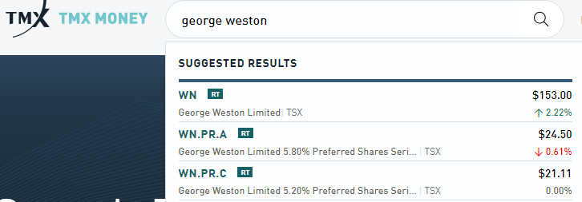
TMX
Note the separate share classes and variation in prices
Share classes
WN = trading symbol for George Weston Limited (owns Loblaws)
PR.A = preferred shares, series A
Trading value

Slide 8
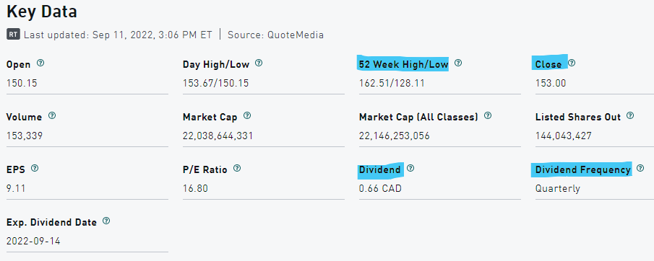
Share information
Note the following:
Closing price
52 week high/low - is the stock near the peak for this year?
Dividend amount and frequency

Slide 9
Questions?

Slide 10
2. Identification / Qualification stage
Quick lookups to confirm capacity
SEDAR: (Canadian) search by companies - annual salary and shareholdings
SEDI: (Canadian) search by individuals - current shareholdings
SEC/EDGAR: (American) search by companies and individuals - annual salary; annual and current shareholdings

Slide 11
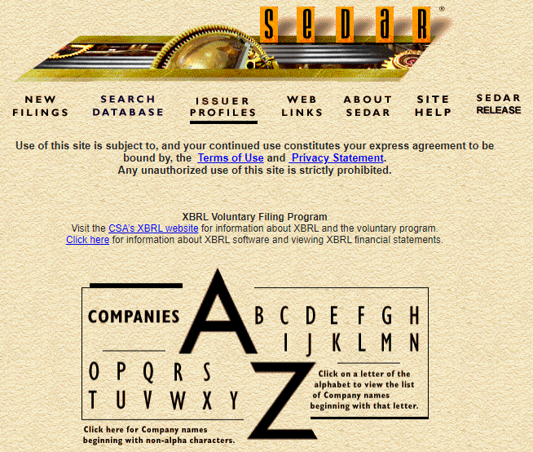
SEDAR: Canadian Salary and Stock information
SEDAR is Canada’s repository for public company filings:
Management Information Circulars (proxy circulars) disclosing salary and stock information
Annual and quarterly reports
Acquisitions and mergers
Initial public offerings
Filings date from 1997
English and French

Slide 12
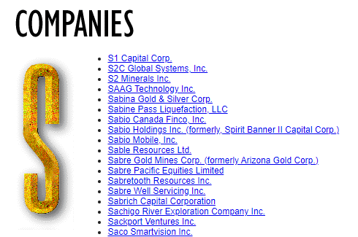
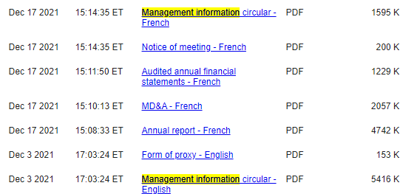
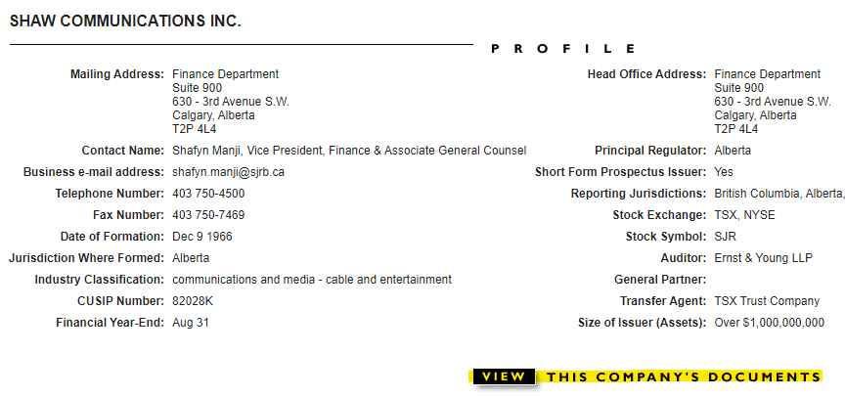
Navigation - drill down by current company name
Control + F (find) is your friend throughout this site!

Slide 13
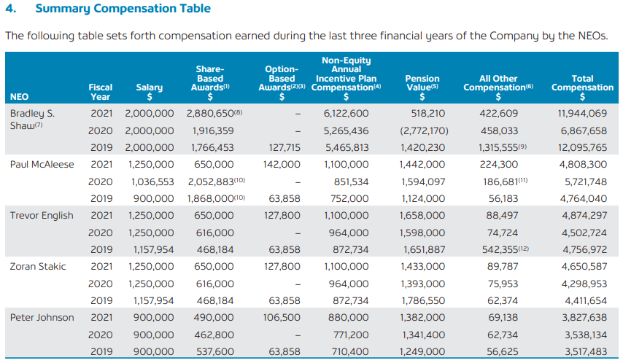
Summary Compensation Table
Lists the top 5 highest-paid individuals - the named executive officers (NEOs)
Last three fiscal years
Cash: salary, bonus (non-equity annual incentive) & pension
Shares and options
All other: Insurance, transportation

Slide 14
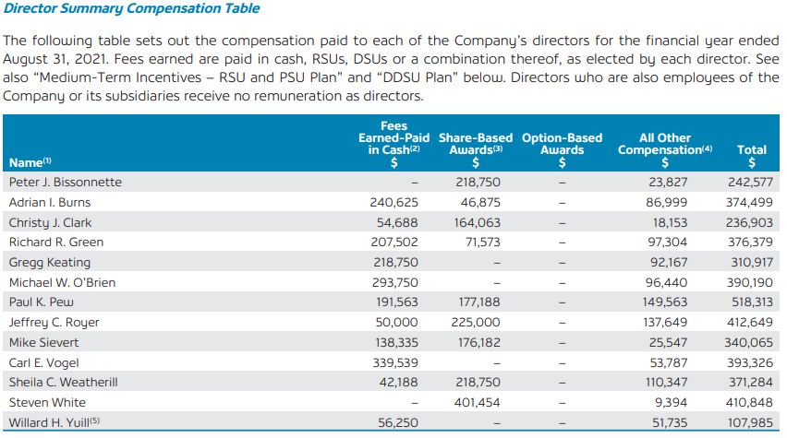
Director summary compensation table
Cash
Deferred share units (DSUs) redeemable as cash when retire from board
Restricted share units (RSUs) - vest over time

Slide 15
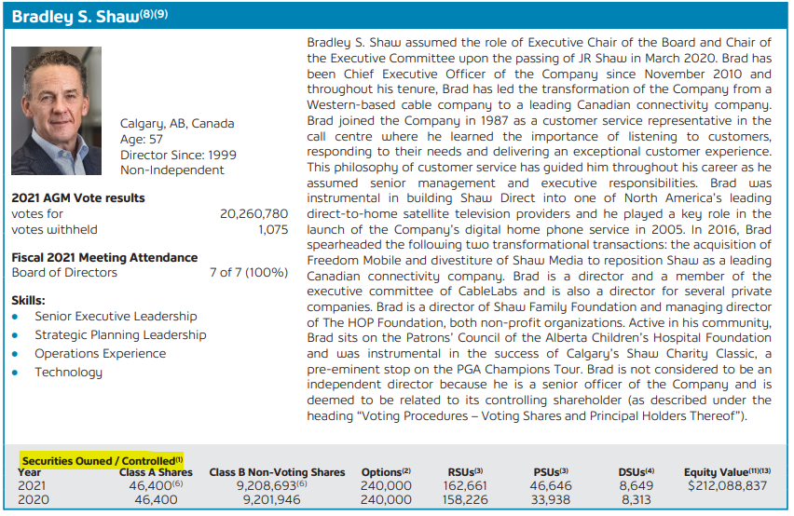
Shareholdings
Securities Owned / Controlled:
Note two share classes: A and B - refers to voting rights but also different share prices

Slide 16
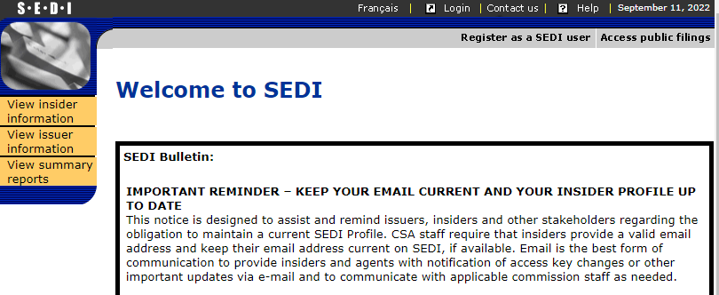
System for Electronic Disclosure by Insiders (SEDI)
Trading activities of directors, senior officers and holders of 10% or more of shares (Insiders)
Filings within 5 days of transaction
Filings since 2003
English & French

Slide 17
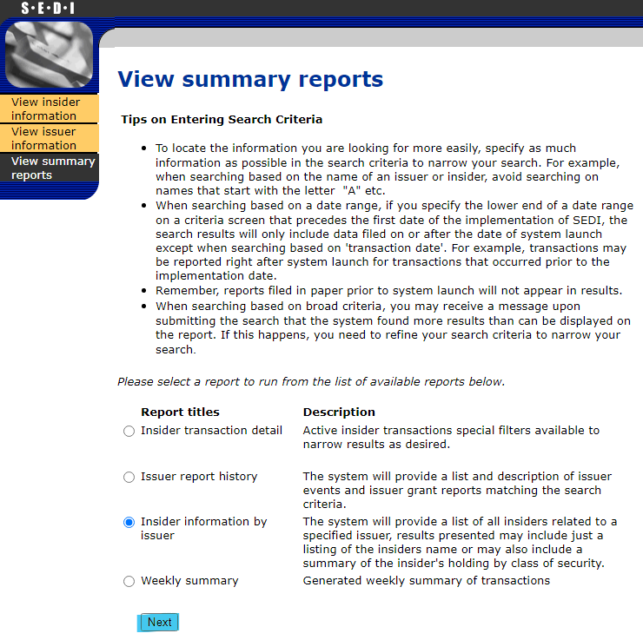
Navigation
Quick look up for summary of shareholdings:
Insider information by Issuer
Insider = director, executive, or holder of 10% or more of shares
Issuer = company

Slide 18
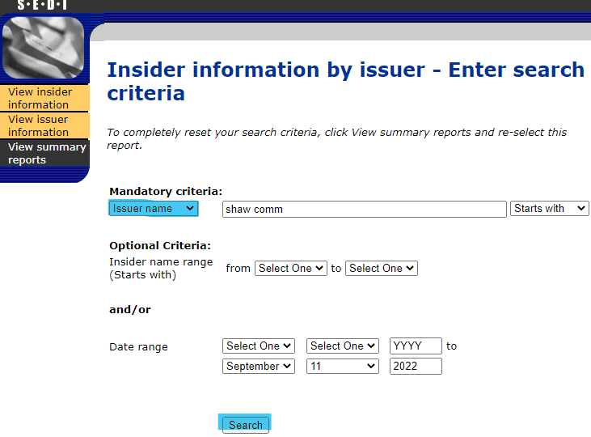
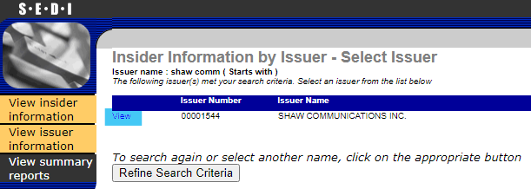

Slide 19
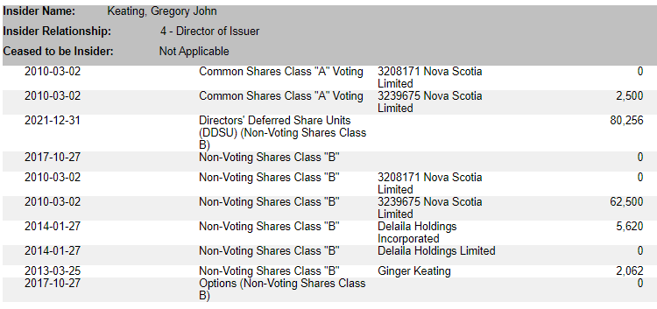
Summary of shareholdings from SEDI:
Date of last transaction
Share class
Ownership type: Directly (blank) or indirectly held (another person or org)
Total holdings of each share class

Slide 20
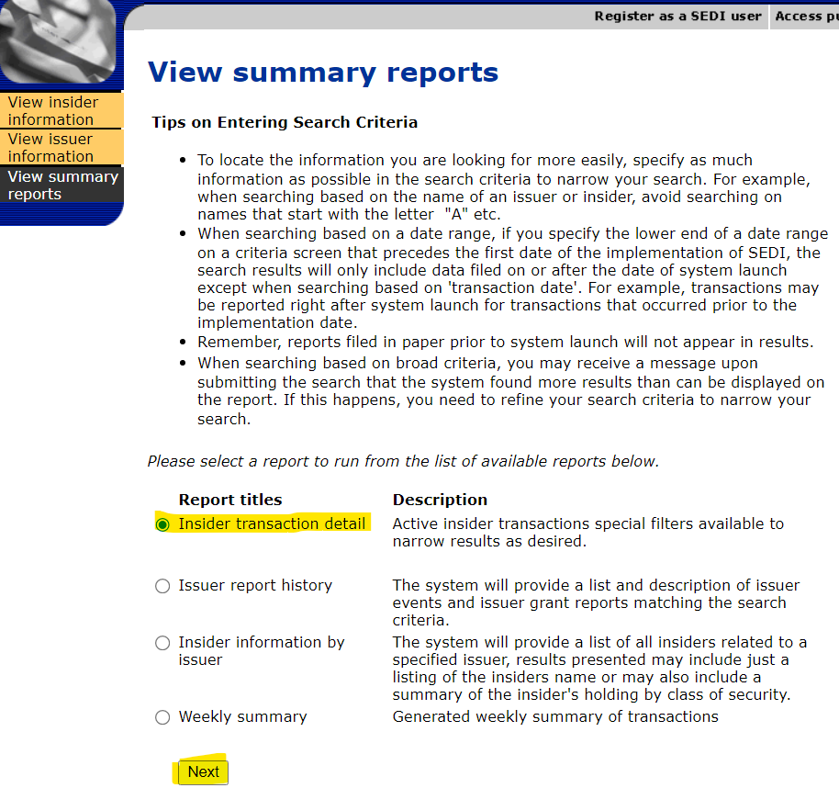
See all companies and transactions in one place
Insider transaction detail -
Search by individual name
See all of the companies they have shareholdings with
See all transactions - receiving, acquiring, selling and gifting shares

Slide 21
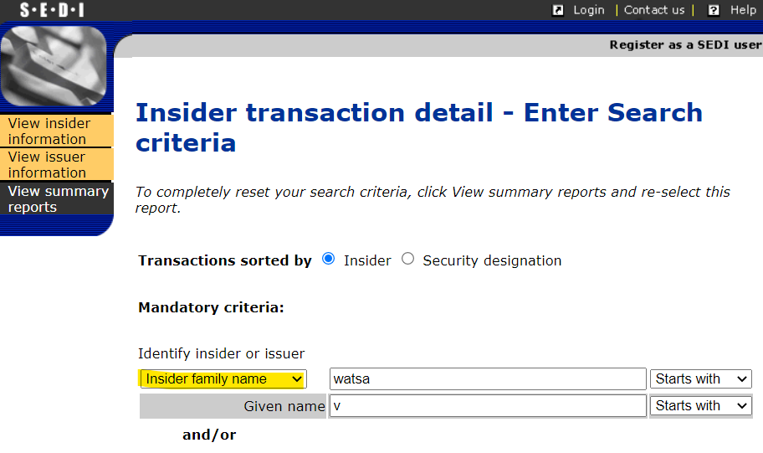
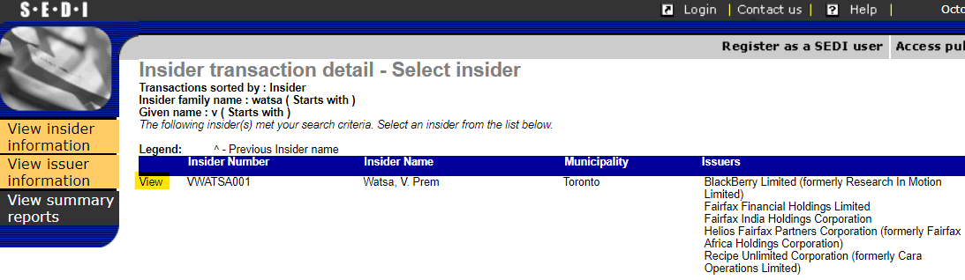
Navigation - Insider transaction detail

Slide 22
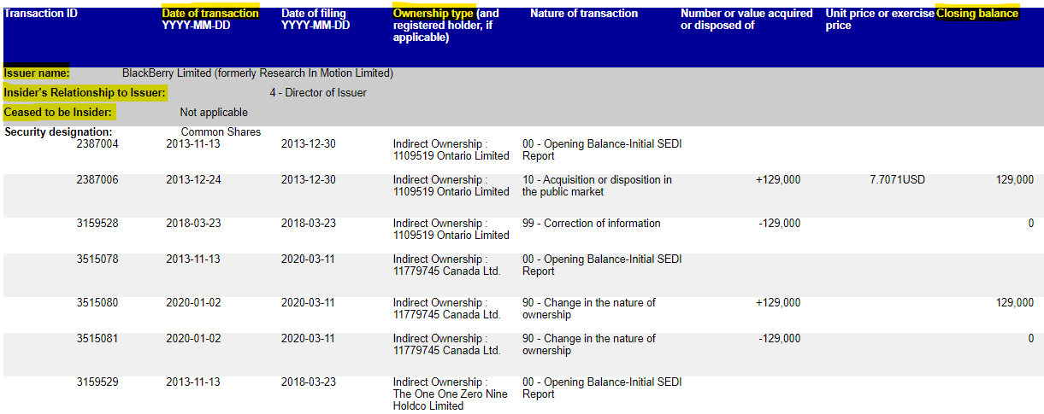
Sample transaction detail report

Slide 23
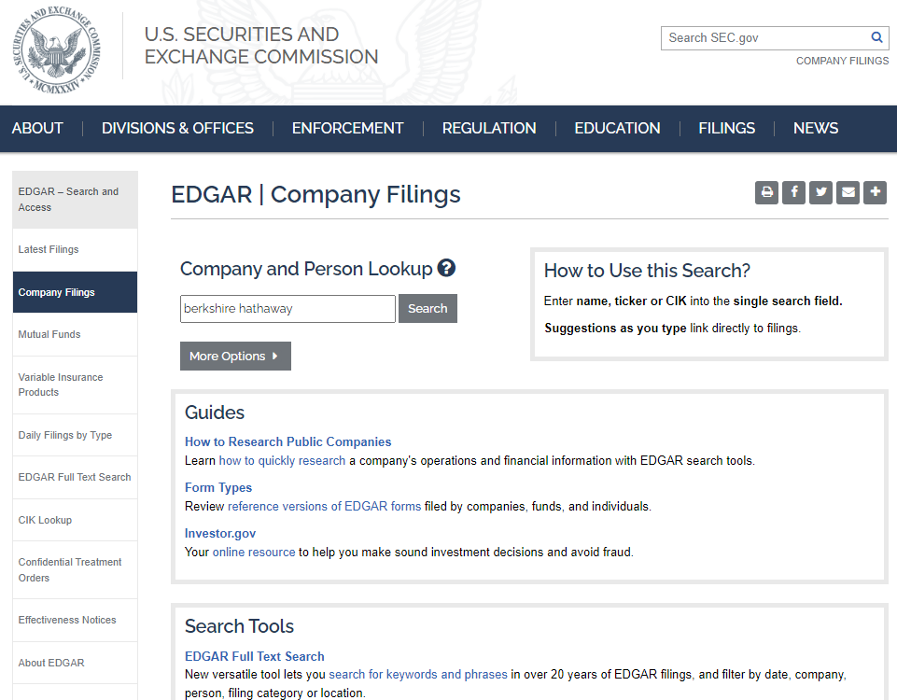
SEC: American Salary and Stock Information
SEC (EDGAR) is America’s repository for public company filings:
Proxy circulars disclosing salary and stock information
Annual and quarterly reports
Acquisitions and mergers
Initial public offerings
Filings date from 1993

Slide 24
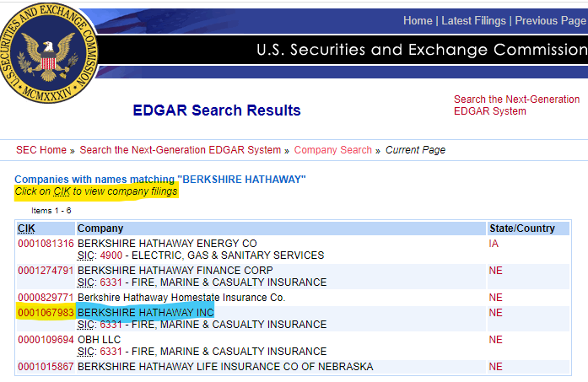
SEC Navigation:

Slide 25
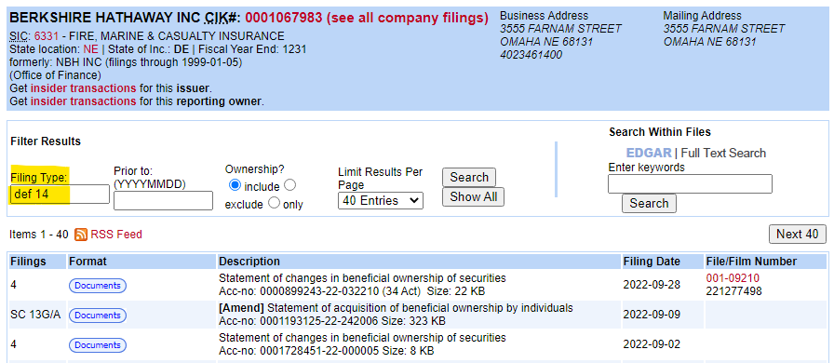
Original version SEC: scroll through list or look up by filing type
Common Filing Types:
DEF 14A = proxy circular
10-Q = Quarterly Report
10-K = Annual Report

Slide 26
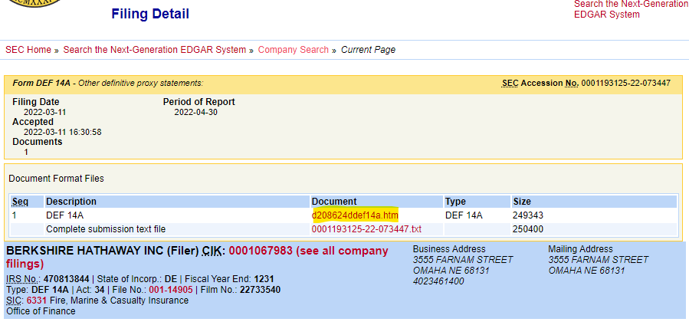
Accessing the documents:

Slide 27
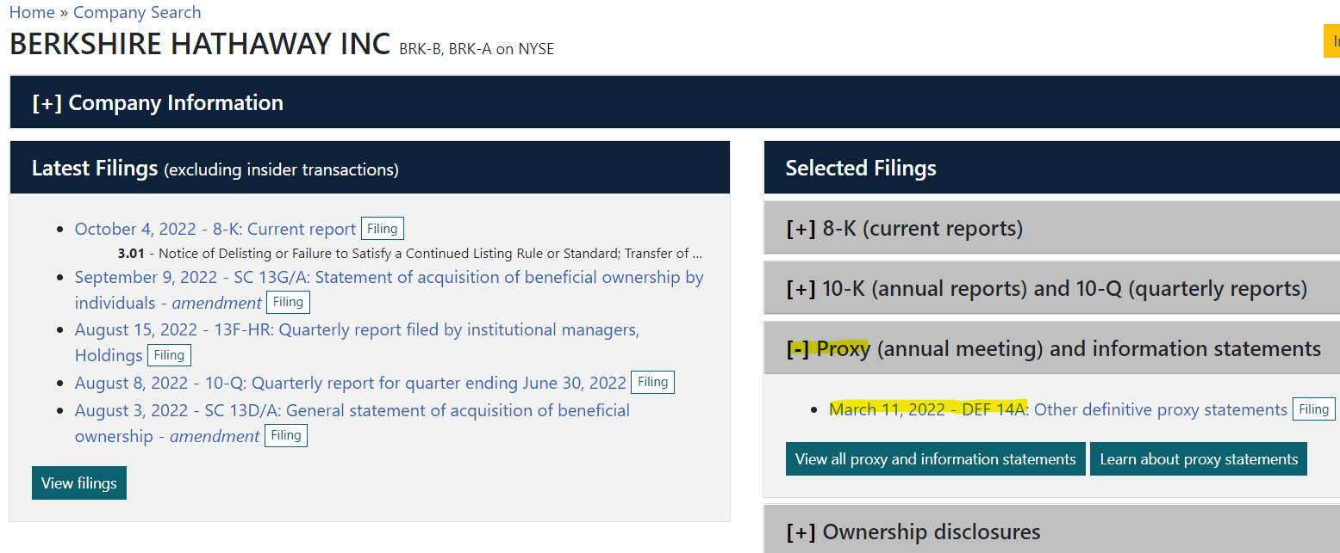
New Look for SEC:

Slide 28
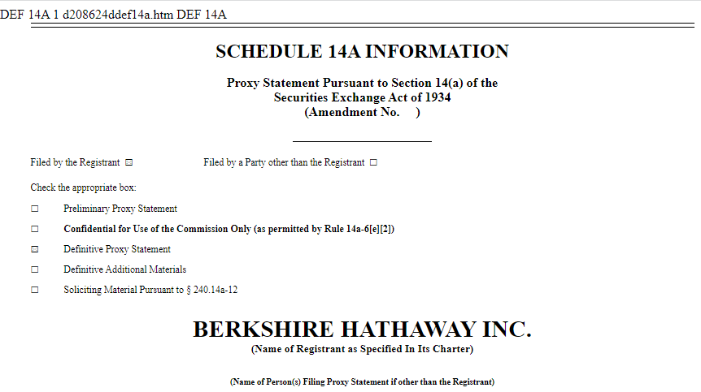
Typical Proxy Circular:

Slide 29
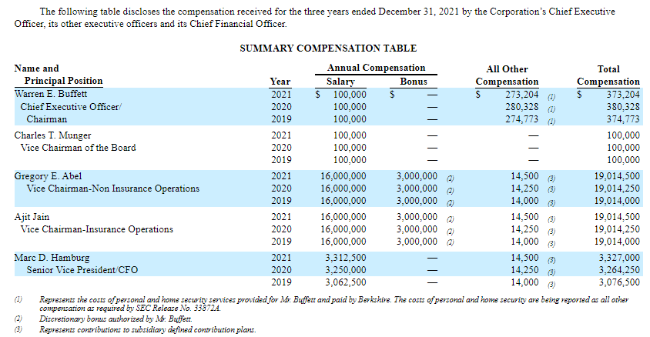
A familiar friend - the Summary Compensation Table:

Slide 30
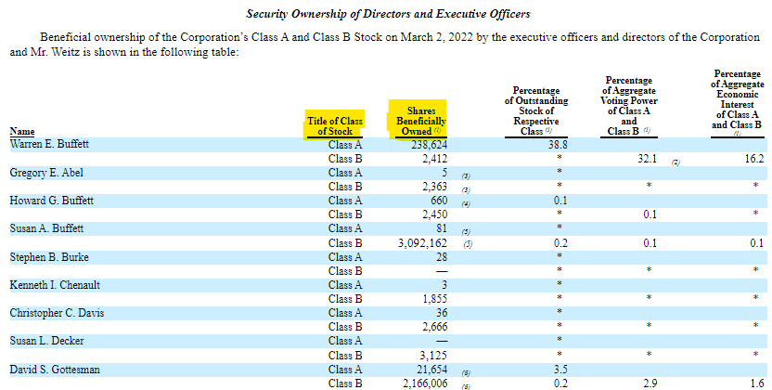
Security Ownership of Directors and Executive Officers

Slide 31
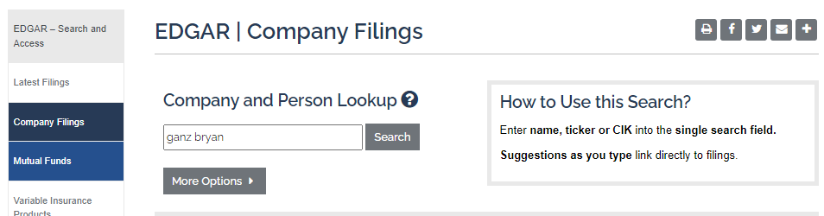
SEC: look up by individual
Navigation:
Last name first name

Slide 32
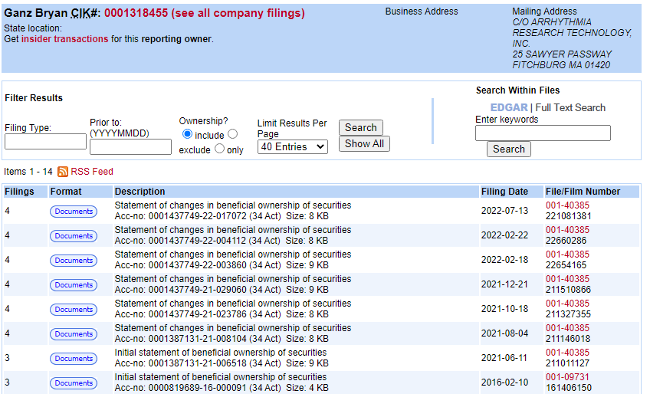
Individual filings:

Slide 33
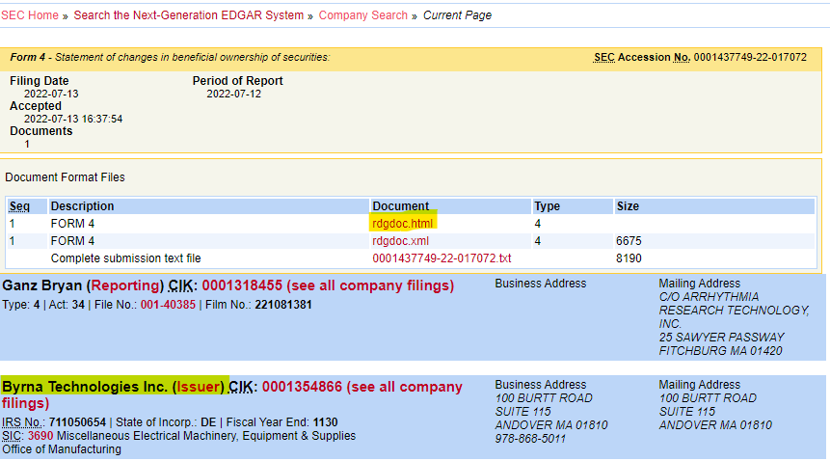
Filings are by each company - there is no summary of all companies in one place like SEDI

Slide 34
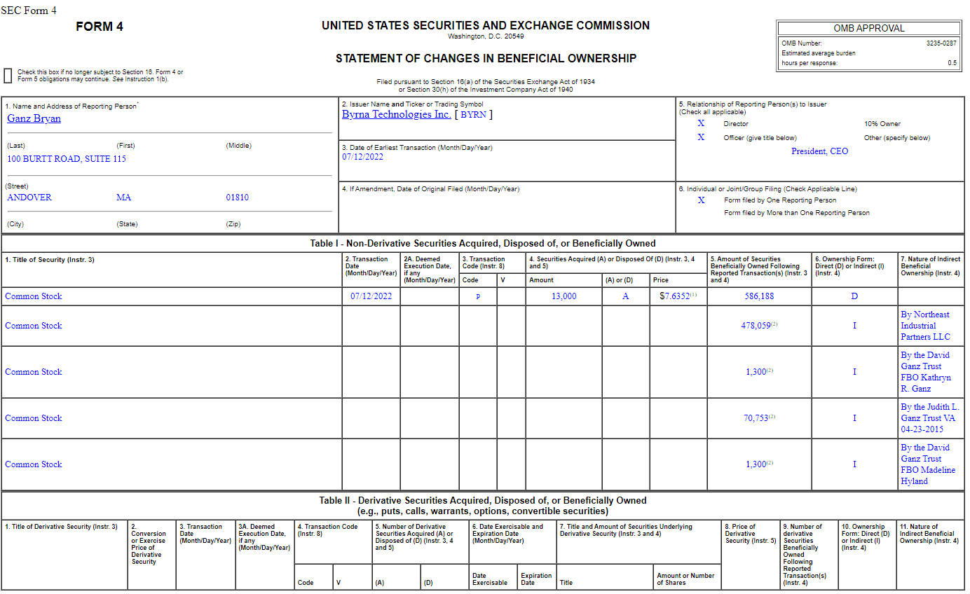

Slide 35
Shareholding Calculations
Determine:
The most recent closing balance (100 shares)
For each share class (ABC, ABC.A, ABC.B)
And each ownership type (Direct and Indirect)
Look up the share value for each share class (using TMX, NYSE, Google or Yahoo Finance)

Slide 36
Sample of share calculation summary I:
Working document:
Company | Ownership | Closing Date | No. of shares | Price per share | Value of shares
ABC | Direct | April 13, 2021 | 823,405 | $34.29 | $28,234,557.45
ABC (DSUs) | Direct | April 13, 2021 | 2031 | $34.29 | $69,642.99
ABC (RSUs) | Direct | March 3, 2021 | 57 | $34.29 | $1,954.53
ABC.B | Direct | March 3, 2021 | 4,234 | $112.93 | $478,145.62
Total Value (Directly held): |  |  |  |  | $28,784,300.59
ABC | 123942 Alberta Ltd. | May 9, 2020 | 47,028 | $34.29 | $1,612,590.12
ABC.A | Doe Family Trust | May 9, 2020 | 1,203,301 | $503.02 | $605,284,469.02
Total Value (Indirectly held): |  |  |  |  | $606,897,059.14
What I would share with the fundraiser: John Doe holds ABC shares worth $28.7M and controls a further $606M in shares through the Doe Family Trust and a holding company.

Slide 37
Sample of share calculation summary II:
Working document:
Company | Closing Date | No. of shares | Price Per share (USD) | Value of shares (USD) | Value of Shares (CDN) April 13, 2021 (exchange rate: 1.2554)
ABC | April 13, 2021 | 293,492 | $302.59 | $88,807,744 | $111,489,242.17
ABC.A | March 3, 2021 | 15 | $23,010.32 | $345,154.80 | $433,307.34
ABC.B | March 3, 2021 | 1,928 | $267.10 | $514,968.80 | $646,491.83
Total Value: |  |  |  |  | $112,569,041.34
What I would share with the fundraiser: John Doe holds ABC shares valued at $112M.

Slide 38
Questions?

Slide 39
3. Cultivation / Solicitation stage
Recommending or confirming target ask amounts with more in-depth searches
Gifts of Securities
Stock options
Former positions
Liquidity events (past share sales)
Compound Annual Growth Rate (CAGR)

Slide 40
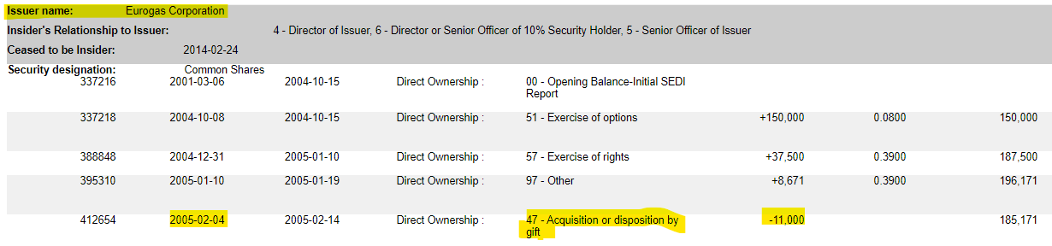
Gifts of Securities
One thing to pay attention to is the nature of the transactions in the transaction detail summary in SEDI - such as whether they have gifted securities in the past.
Individuals from any life stage can gift securities, and your fundraisers should be prepared for those conversations, but you may still want to alert them when it appears to be the primary giving vehicle of the prospect.

Slide 41
Stock Options
What are options?
Options are granted to employees or board members as part of their compensation.
Options enable these Insiders to acquire shares at a lower price than they are currently trading at. This special price is called the exercise price.
When the Insider buys shares at the lower exercise price, and then sells them at the higher share price, they make a profit.
How does it work?
Buy 10 shares for $1.00 (exercise price) = $10
Sell those 10 shares for $2.00 (current share price) = $20
Make a profit of $10
Why are they important?
If someone has exercised a large batch of options and sold them recently, it means they now have a large amount of cash that could be donated.
Having the capital to exercise options also indicates they have cash on hand.

Slide 42
Calculating value of options:
(current share price minus option exercise price) x number of options
For example:
($1.50 - $1.30) x 400,000 = $80,000

Slide 43
Factors affecting option value:
Exercise Price vs. Share Price
If the exercise price is higher than the current share price it means the options have no value or are “under water”. Don’t bother calculating.
Expiry dates
Options must be converted to common shares before their expiration date. If they have expired, don’t bother calculating.
look at when the next batch expire to give the Major Gift officers a heads up that additional equity will become liquid in the near future - or that a deadline is looming to donate them.

Slide 44
Stock Options - as Donations!
Insiders can now donate their stock options, either exercised (converted to shares) or unexercised (cashless exercise).
How does it work?
Exercised options: Insider acquires the shares at the lower exercise price and then donates the shares to a charity (requires capital to acquire the shares). The charity sells the shares at the higher current share price and Insider receives charitable tax receipt for the donation.
Unexercised options: (cashless exercise) Insider either short sells the underlying shares or utilizes a short term loan through their brokerage as a means of acquiring the cash needed to exercise the options. A portion of the proceeds are used to cover the short sell or pay back the brokerage, with the remainder designated to a charity. Insider receives charitable tax receipt for the donation.
Notes:
Note that options are usually included in the Summary Compensation Tables we looked at earlier, as they generally fall under the “long-term compensation” category. Thus you may not need to calculate their value separately, especially as you want to avoid double counting their assets. However, if your fundraiser is keen to discuss donating stock options with the individual, it will be worthwhile to determine their potential value separately. Rather than reporting on “Total Compensation” you could just report their salary and cash bonus to avoid double counting.

Slide 45
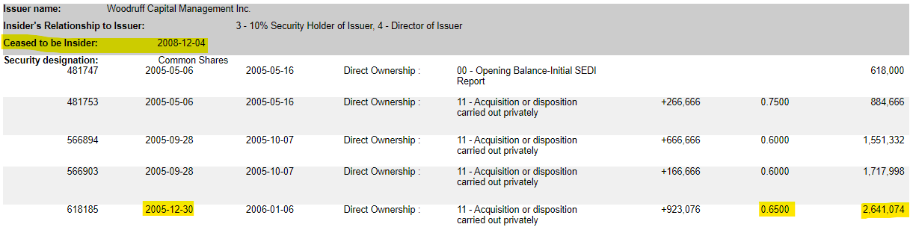
Former positions
Shares don’t disappear when prospects leave a company - either they still have them or they have sold them.
You can assume they still have them, and calculate their value based on their current share price, or you can look up the historical share price from the date they ceased to be an insider and treat them like a past share sale.
Historical share prices are available through TMX, NYSE, Google finance, etc.
Share price
Closing balance

Slide 46
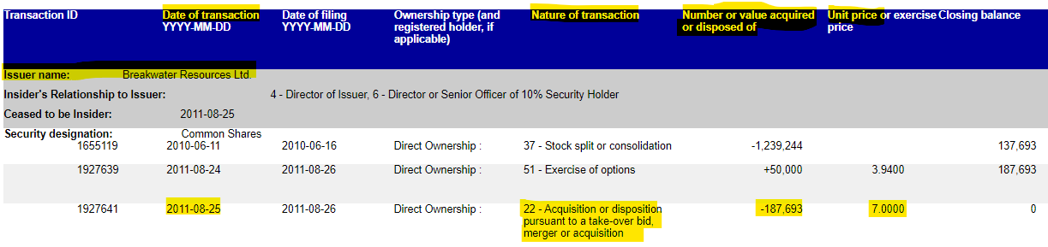
Liquidity events - past share sales
In 2011, Breakwater Resources was acquired by Nyrstar for $7 per share, and John Doe received $1,313,851 for his 187,693 shares.

Slide 47
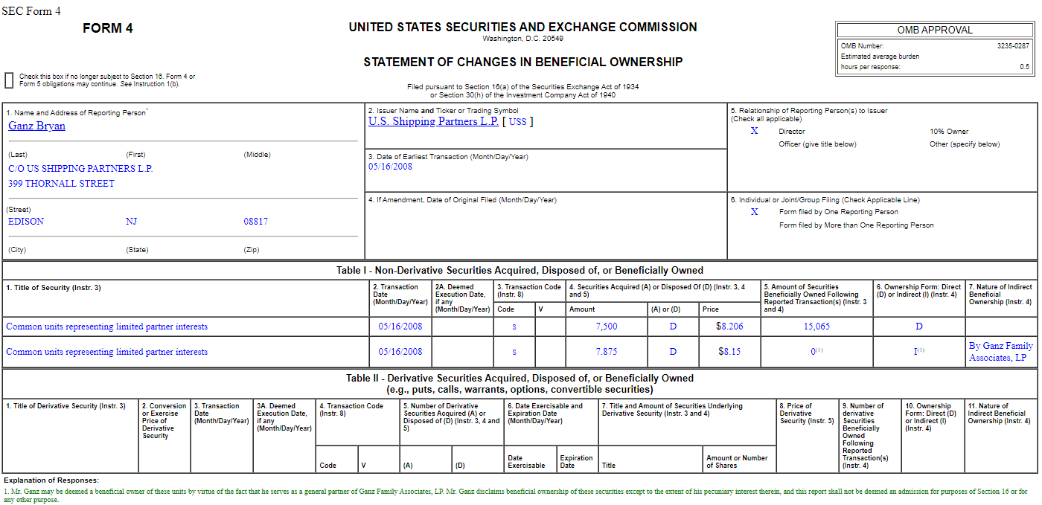

Slide 48
Compound Annual Growth Rate (CAGR)
The compound annual growth rate (CAGR) is the rate of return (RoR) of an investment from its beginning balance to its ending balance, assuming the profits were reinvested at the end of each period of the investment's life span.
It represents one of the most accurate ways to calculate and determine returns for individual assets, investment portfolios, and anything that can rise or fall in value over time. Over the long run, the stock market has had an inflation-adjusted annualized return rate of between 6% and 7%. Many investment managers for high net worth individuals can achieve 10% or more in annual returns.
Estimating CAGR can be helpful for estimating the rate of return on past stock sales, which have likely been re-invested in your prospect’s investment portfolio.

Slide 49
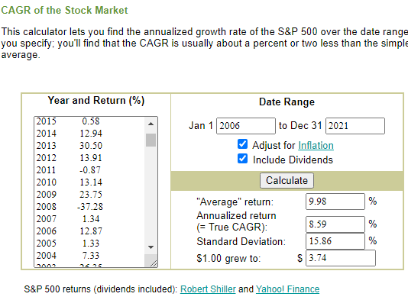
Tools for calculating CAGR
Value of stock sale
Year | Amount | CAGR (8.59%)
2006 | $8,398,400 | $721,423
2007 | $9,119,823 | $455,991
2008 | $9,575,814 | $478,791
2009 | $10,054,604 | $502,730
2010 | $10,557,335 | $527,867
2011 | $11,085,201 | $554,260
2012 | $11,639,461 | $581,973
2013 | $12,221,434 | $611,072
2014 | $12,832,506 | $641,625
2015 | $13,474,131 | $673,707
2016 | $14,147,838 | $707,392
2017 | $14,855,230 | $742,761
2018 | $15,597,991 | $779,900
2019 | $16,377,891 | $818,895
2020 | $17,196,786 | $859,839
2021 | $18,056,625 | $902,831
2022 | $18,959,456 | $947,973
Potential current value

Slide 50
Questions?

Slide 51
Thank you
Erin Shantz
Development Associate, Principal Gifts
University of Alberta
eemoffat@ualberta.ca

Slide 52
Links to resources
SEDI
SEDAR
SEC EDGAR
TMX - Canadian share price lookup
Yahoo Finance, Google Finance - American share price lookup
Moneychimp - Compound Annual Growth Rate (CAGR)
Bank of Canada Currency Converter

