Slide 1


Onboarding and Training New Prospect Researchers for Success
Shahin Sharma,
Julie Linkletter and Lisa Ren

Slide 2
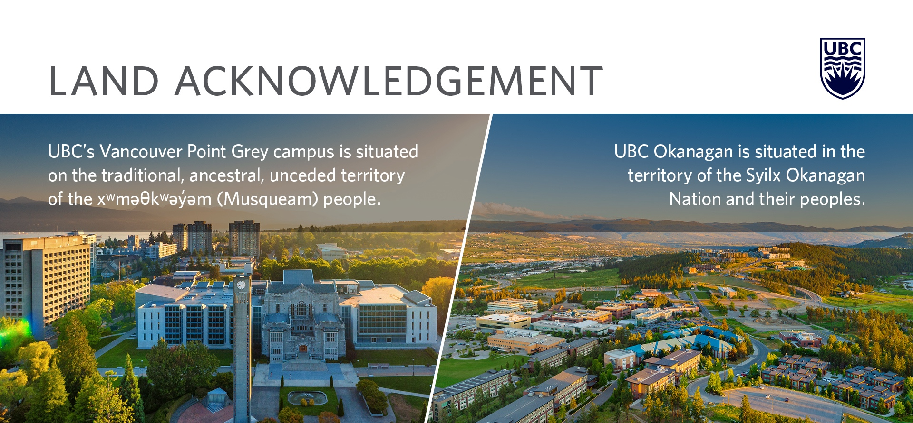

Slide 3
The Resource Manual – Shahin
Training New Researchers – Julie
Personal Experiences - Lisa

Slide 4

Resource Manual – What
About prospect research at UBC
To train new team members
Reference for all
“Resource” vs “Training” manual.

Slide 5
Resource Manual – Why
Formal process
Consistent
Comprehensive
Easy Access

Slide 6

Resource Manual – How
Clarify vision
Seek feedback from the team
Select support team

Slide 7
Resource Manual – How (cont.)
Design template
Create list of topics
Formalize process & timelines

Slide 8

Resource Manual – How (cont.)
Write, Edit, Re-write
Provide regular updates to the Manager
Present final product to the team
Invite ongoing edits and feedback

Slide 10
Training New Researchers

Slide 11
Using the resource manual to train
new researchers
Consistent
Equitable
Thorough

Slide 12
The Research and Prospect Analytics
team at UBC
Director
Five Research Analysts
One Prospect Analyst
Four Research Specialists
Work-Learn student (as needed)

Slide 14
Training over Zoom
Easily share our screen
More visually accessible
Flexible meeting time and place

Slide 16
We all train new colleagues
Use the resource manual for consistency
Train from different perspectives and experiences
Capacity building
Relationship building

Slide 17

Personal Experiences

Slide 18
Joining the team as a new researcher
My experience and story from UBC Work Learn Student for the Research and Prospect Analytics Team to a full-time Research Specialist
Completing the training, team-building and relationship-building, big takeaways, and how to get the most out of the training

Slide 19
Completing the Orientation & Training Sessions
My experiences, and why they’re important, as someone who just recently went through the entire orientation and training sessions
Flow of the training sessions – why was this important to me, what does this mean for a new researcher on the team
Desk–time: why is it important, how did it help me during the formal training process

Slide 20
Team-Building & Relationship Building
How did training sessions help with my own relationship building with the team
How did team-building and relationship building aid me in my new role as a researcher
Why was this aspect of the formal training session important to me as a new researcher?

Slide 21
Big Takeaways
Some examples from the formal training and orientation and how it helped me in my new work and position
The resource manual – stocks and financial indicators
Available resources – templates and team members
Different perspectives from the team

Slide 22
What did I do as a researcher to get the most out of
my orientation and formal training process
Notes
Review, revise, and review
Exploring and testing new software and databases
Questions, questions, questions!

Slide 23
Many thanks!
Julie Linkletter, Research Analyst
Julie.Linkletter@ubc.ca
Lisa Ren, Research Specialist
Lisa.ren@ubc.ca
Shahin Sharma, Research Analyst
Shahin.Sharma@ubc.ca

